Slide 1
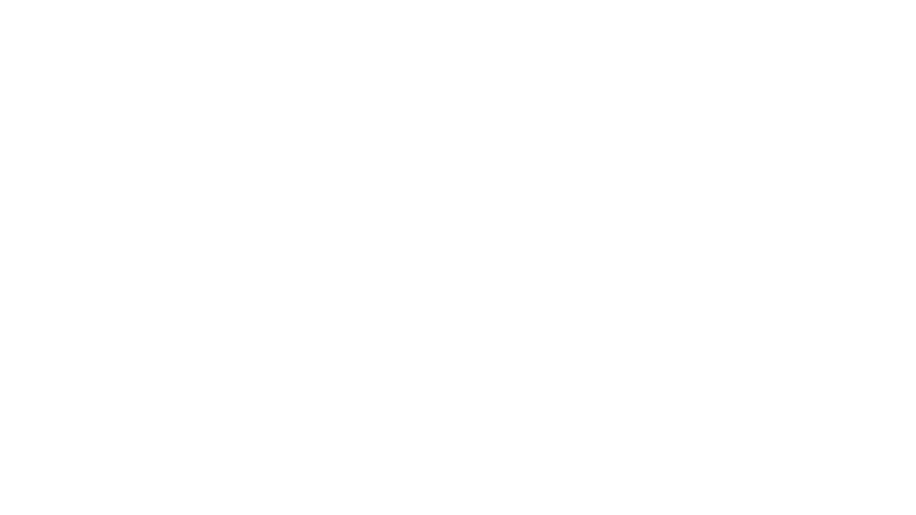

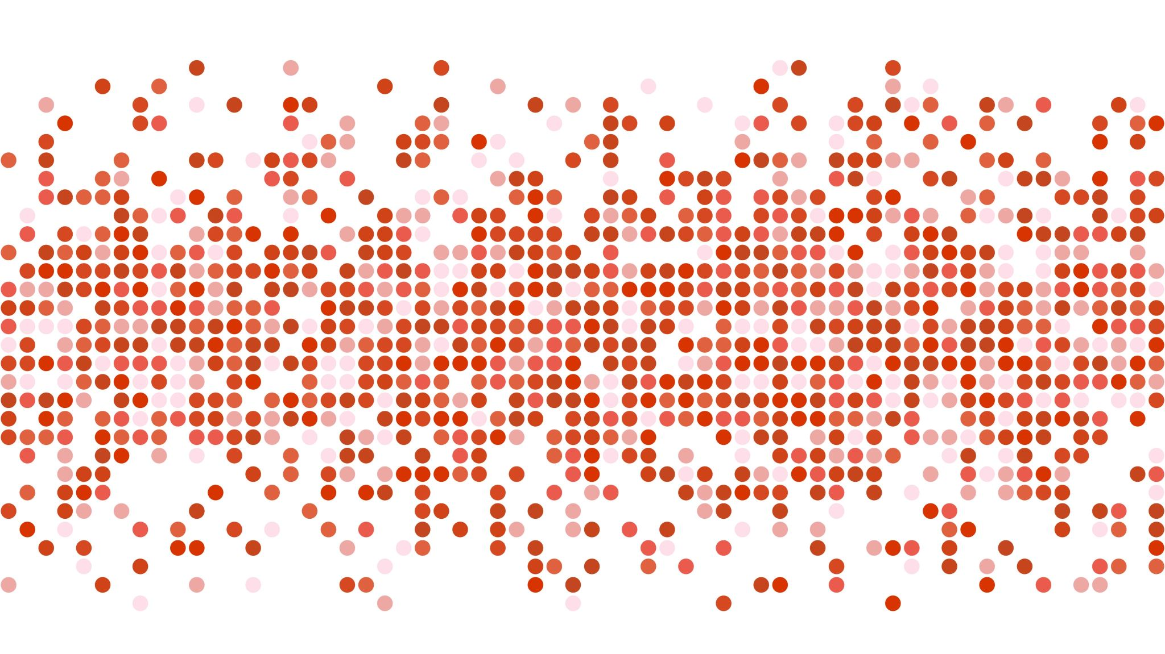
Customer SEGMENTATION and MARKET BASKET ANALYSIS FOR AN ONLINE RETAIL
Bhavya Sree BINDELA
A20448208
Group: 320

Slide 2
INTRODUCTION
Customer segmentation is the process of dividing the customers into different groups based on their behavior with the company. Using customer segments, the company can market their strategies to each group effectively.
Market Basket Analysis is a technique to identify the strength of association between pairs of products that are purchased together.
This technique is based on a concept that if a person buys a product A, how likely the person will buy a product B.
Customer Segmentation and Market Basket Analysis is to explore different types of customers and their granular purchase behavior patterns.

Slide 3

DATA SET
Dataset contains the Business data, and this data set belongs to a UK-based registered non-store online retail.
This Data set contains all the transactions data occurred between 01/12/2010 and 09/12/2011.
Number of Instances : 541909
Online Retail Dataset
Attribute | Description | Data Type
InvoiceNo | Invoice number | Character
StockCode | Product Code | Character
Description | Product Name | Character
Quantity | Quantity of each product per transaction | Number
InvoiceDate | Invoice Date and Time | Number
UnitPrice | Price of the Product per unit | Number
CustomerID | Customer Number | Number
Country | Country Name | Character

Slide 4

RESEARCH PROBLEMS
Identify the customers into different groups based on their behavior with the online retail. Identify the Loyal Customers.
Identify Top 10 Association rules for the products purchased in the online retail.

Slide 5
PROPOSED SOLUTIONS
Identify the customers into different groups based on their behavior with the online retail.
RFM Analysis is the data-driven customer segmentation technique.
Recency : Number of days from the last purchase
Frequency : Number of visits
Monetary : Total amount spent
we use both K-means Clustering and Hierarchal clustering algorithms on RFM data for customer segmentation.
Identify Top 10 Association rules for the products purchased in the online retail.
Group the products based on InvoiceNo and apply Apriori algorithm to find the association rules for the products.

Slide 6

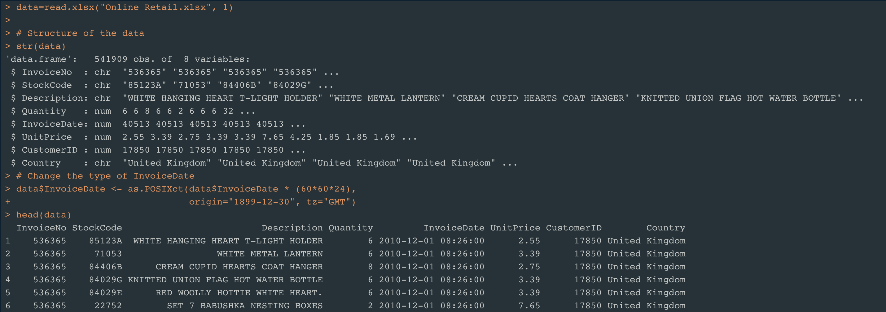
Load the Data
Observations = 541909
Variables = 8
Change InvoiceDate type from Number to Date

Slide 7

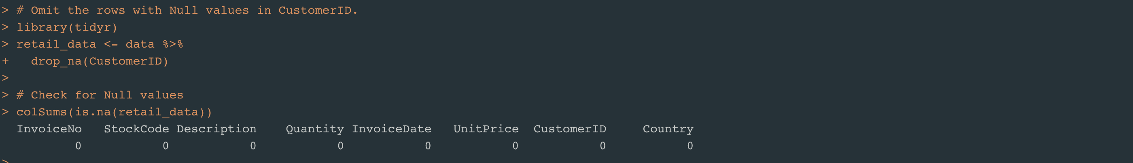
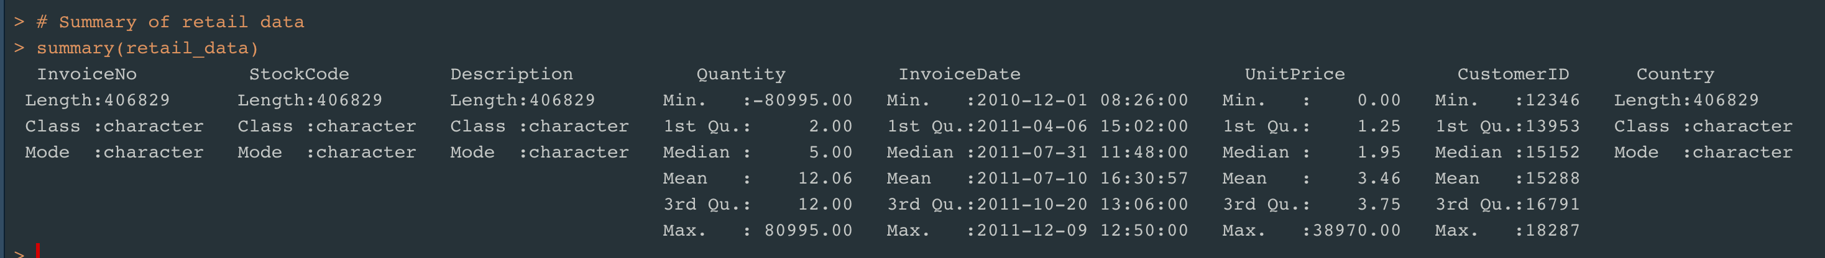
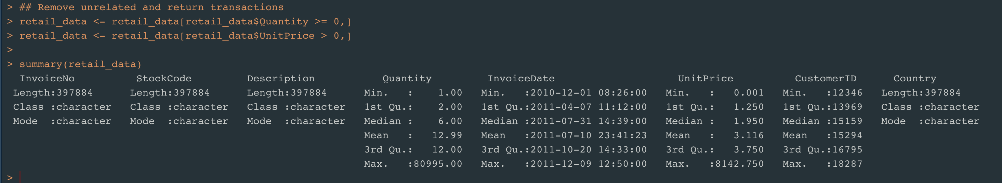
Pre-Processing the Data
Handling Missing values
Remove return Transactions - Summary of data

Slide 8
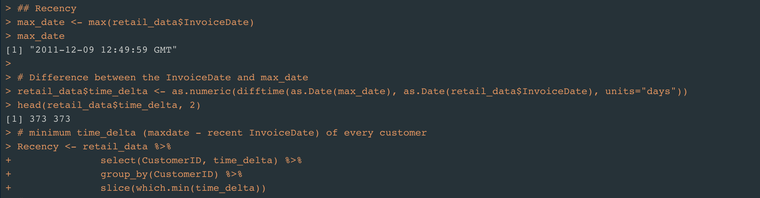
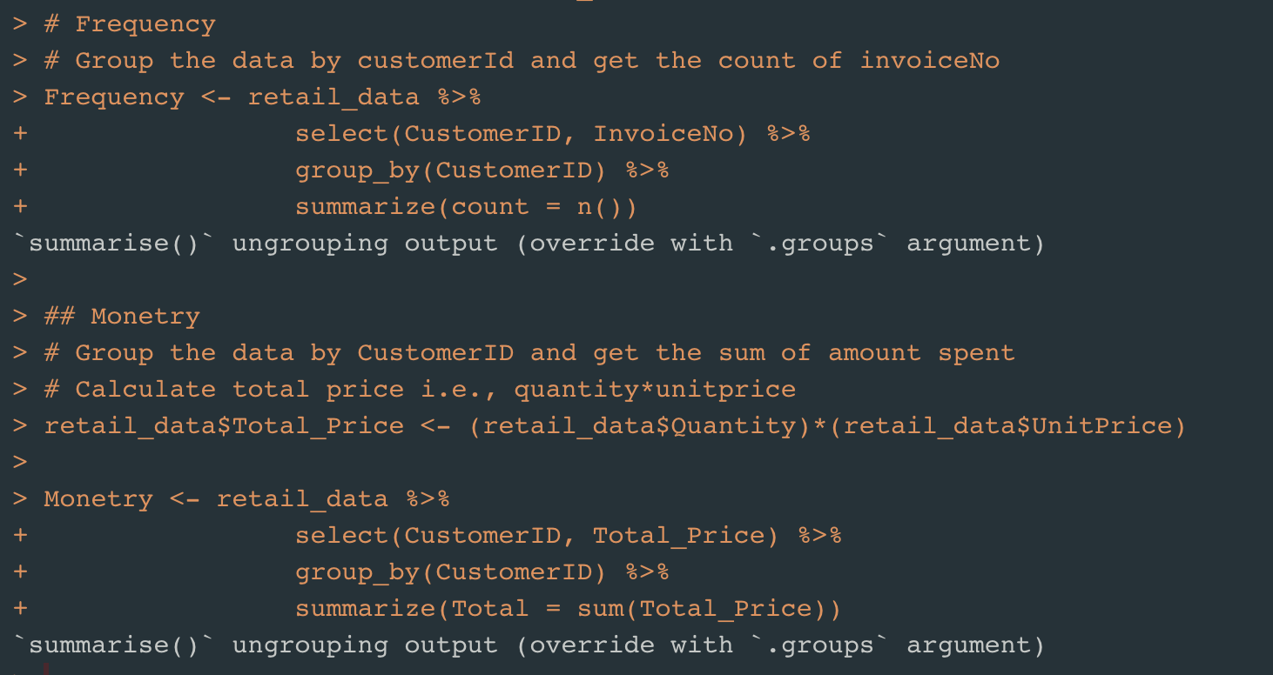
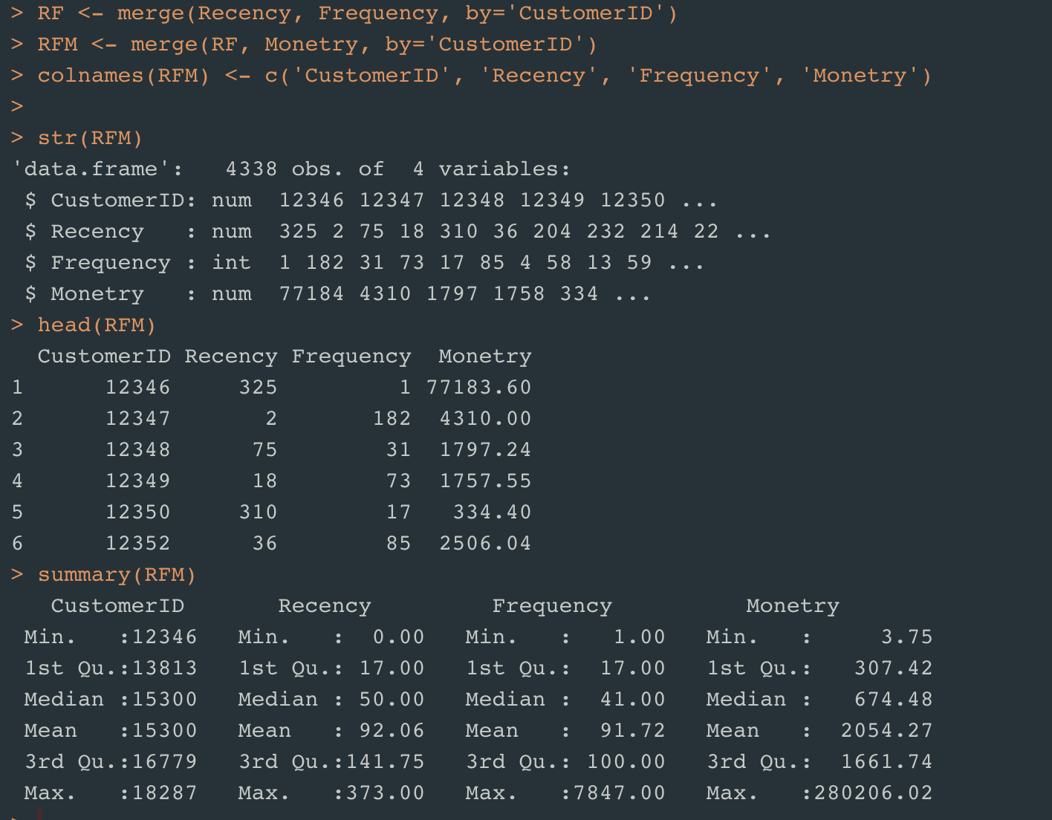
Customer Segmentation – Calculate RFM
Recency : Number of days since last Purchase.
Frequency: Number of visits.
Monetary: Total amount spent.

Slide 9
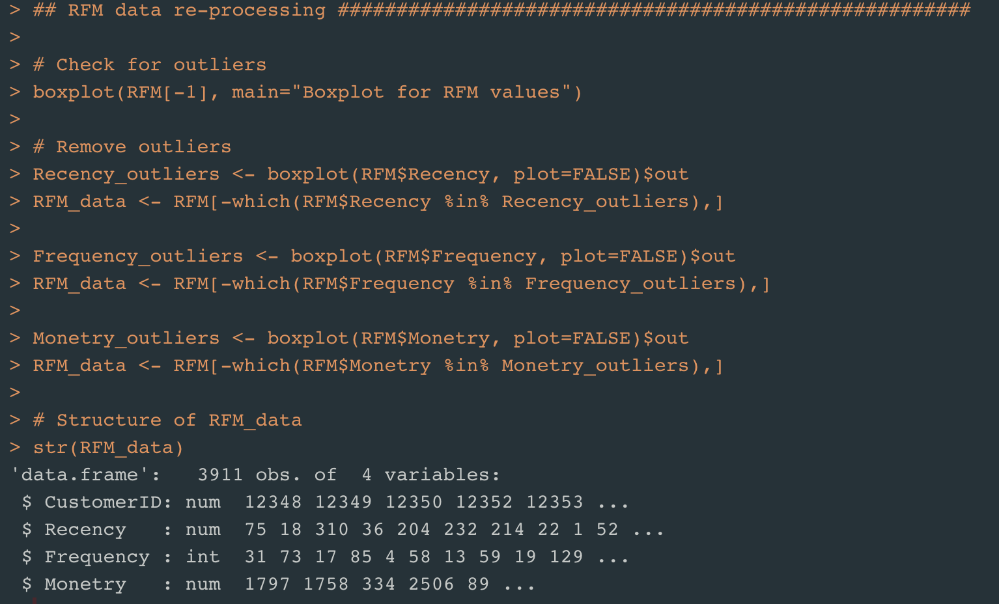
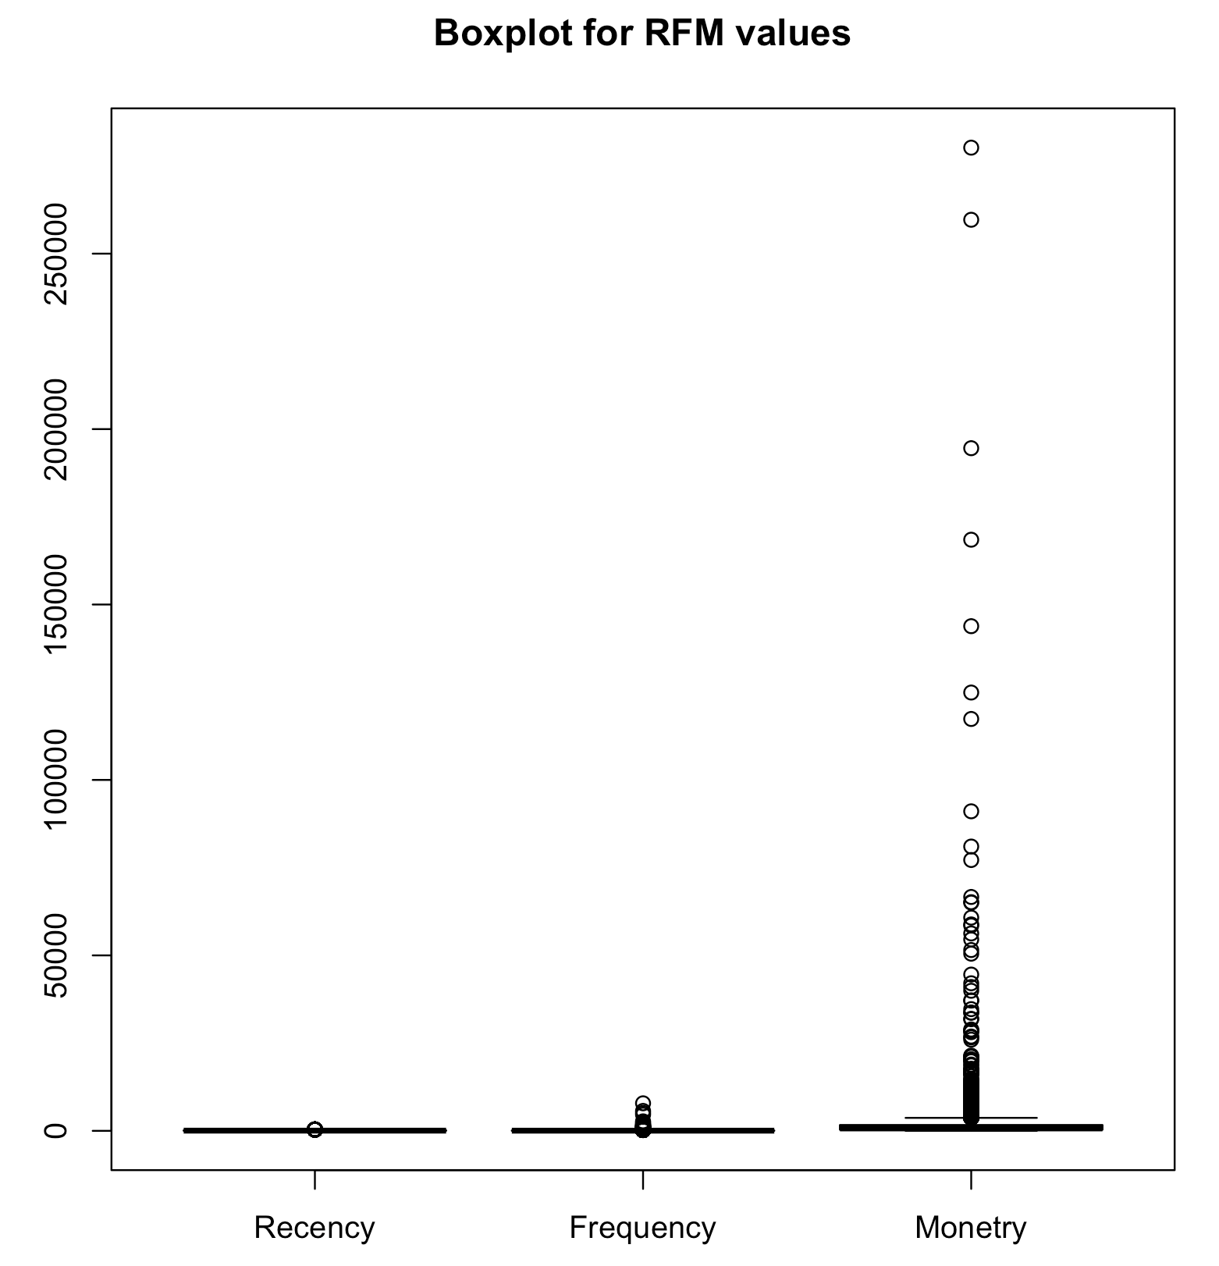
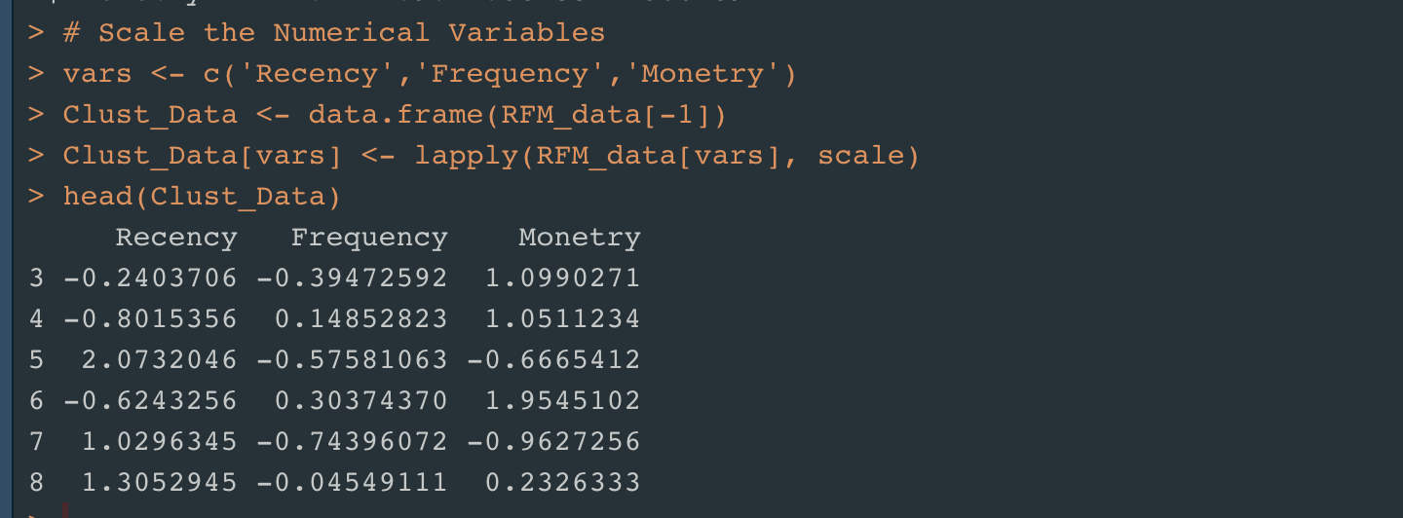
RFM data Pre-Processing
Removing Outliers
Scale the data

Slide 10
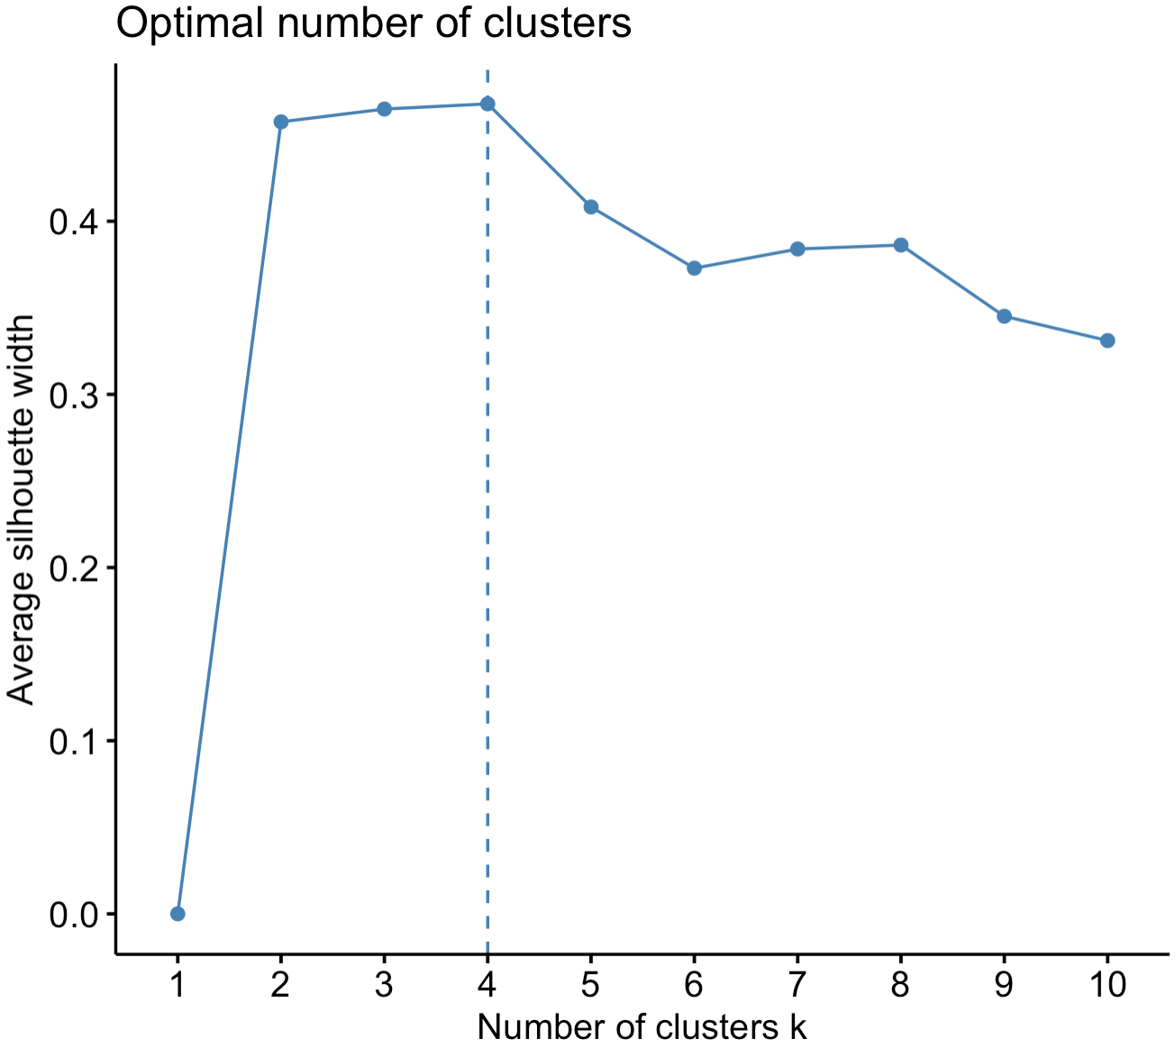
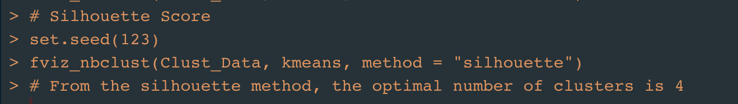
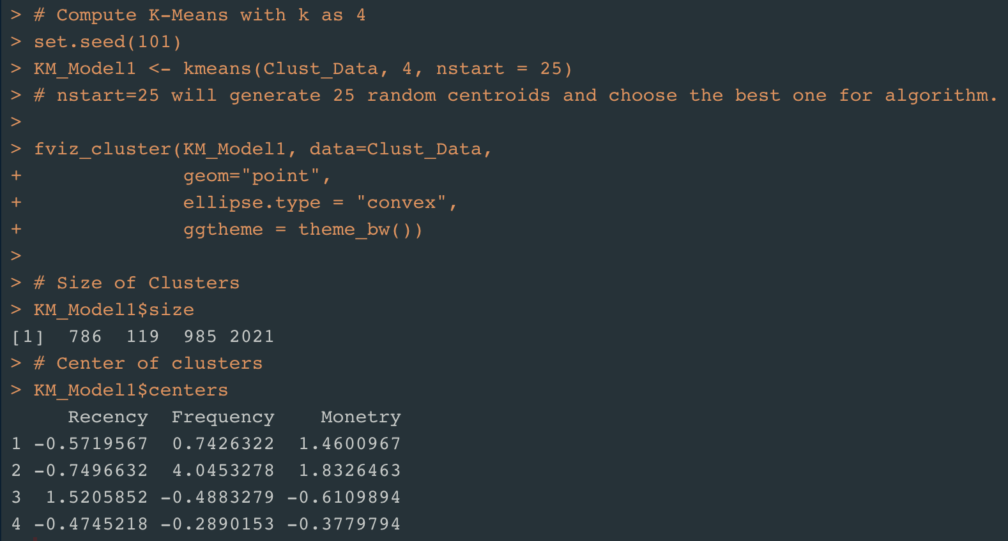
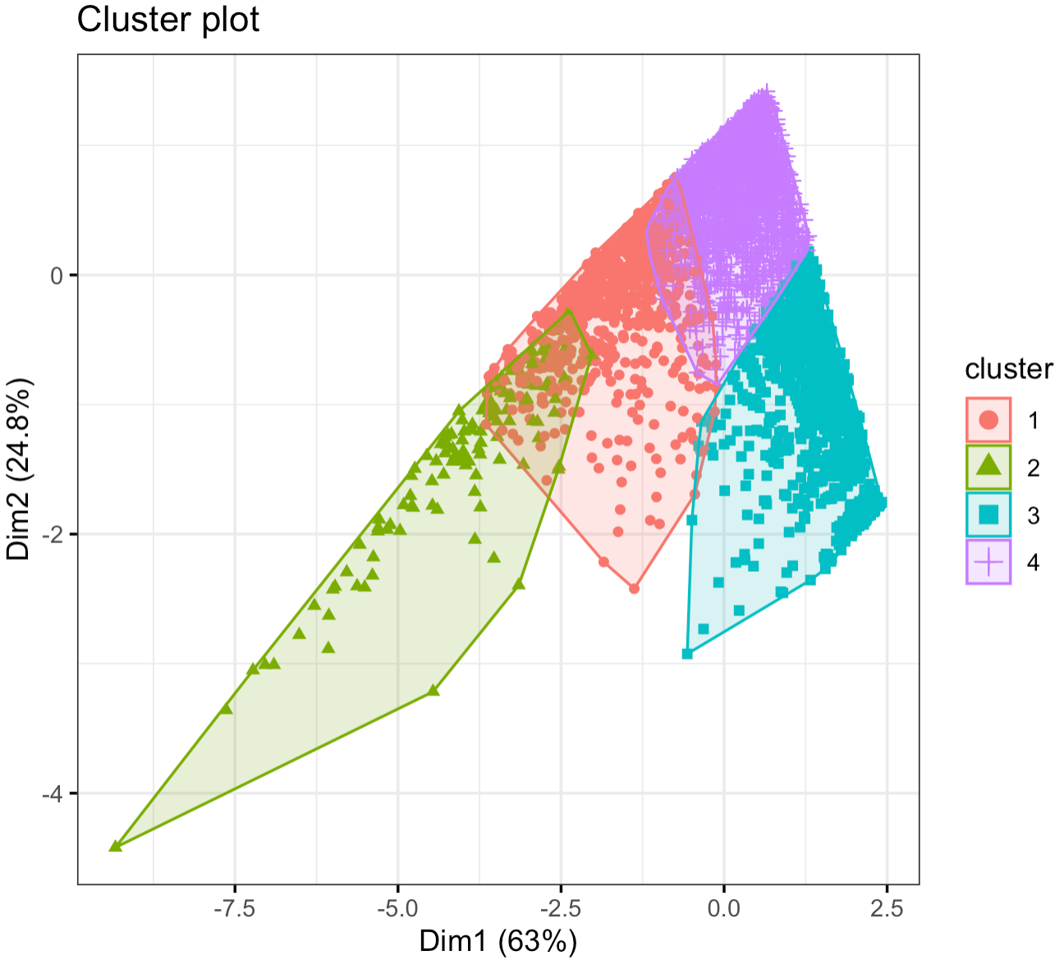
K-Means Clustering – K with Silhouette Method
Silhouette Method
Silhouette Score is a measure of how similar an object is to its own cluster. Ranges from -1 to +1
K = 4

Slide 11
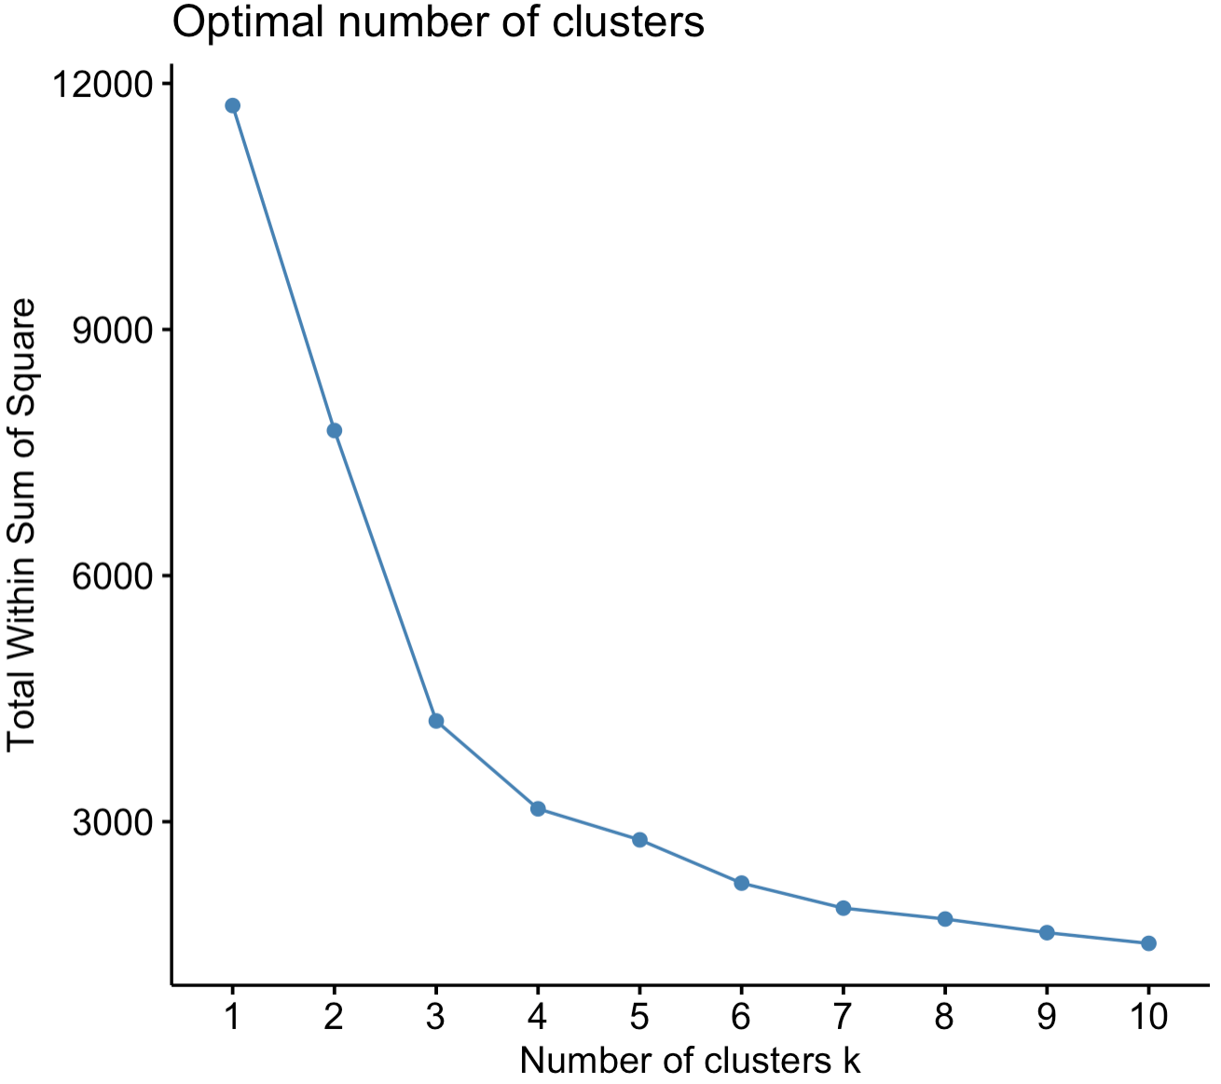
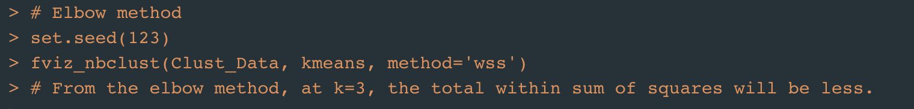
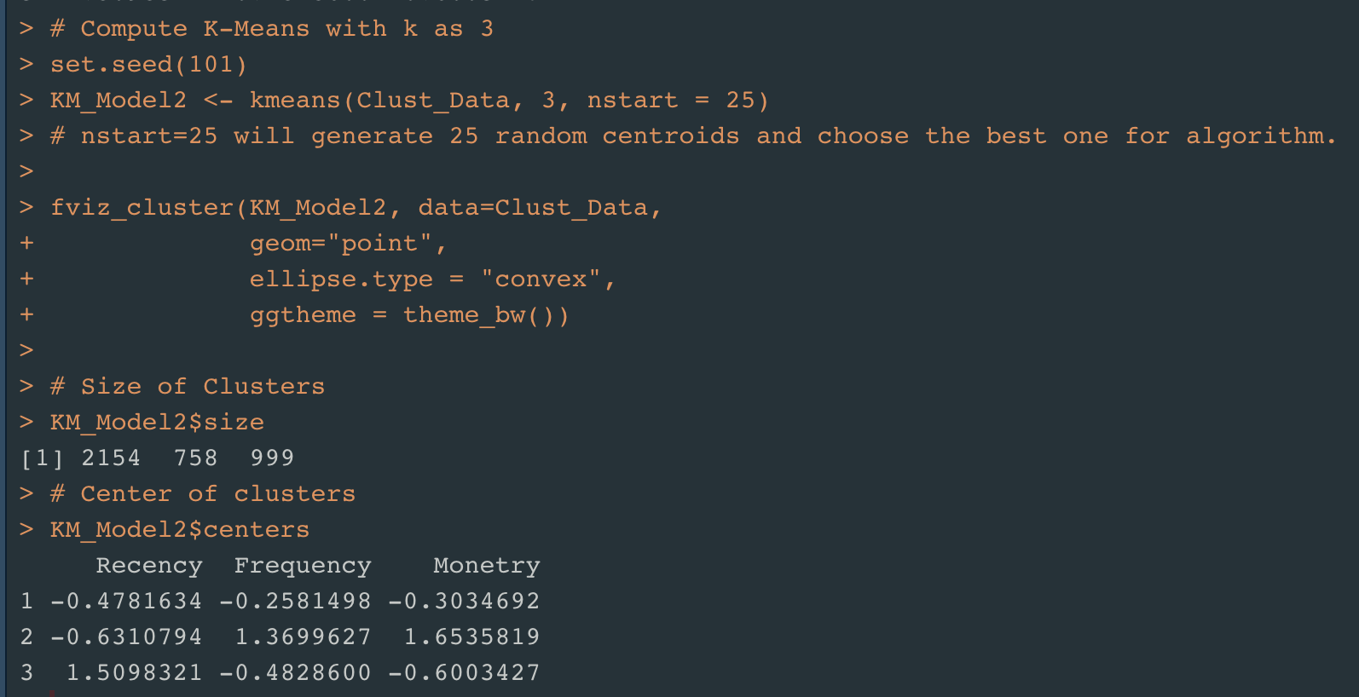
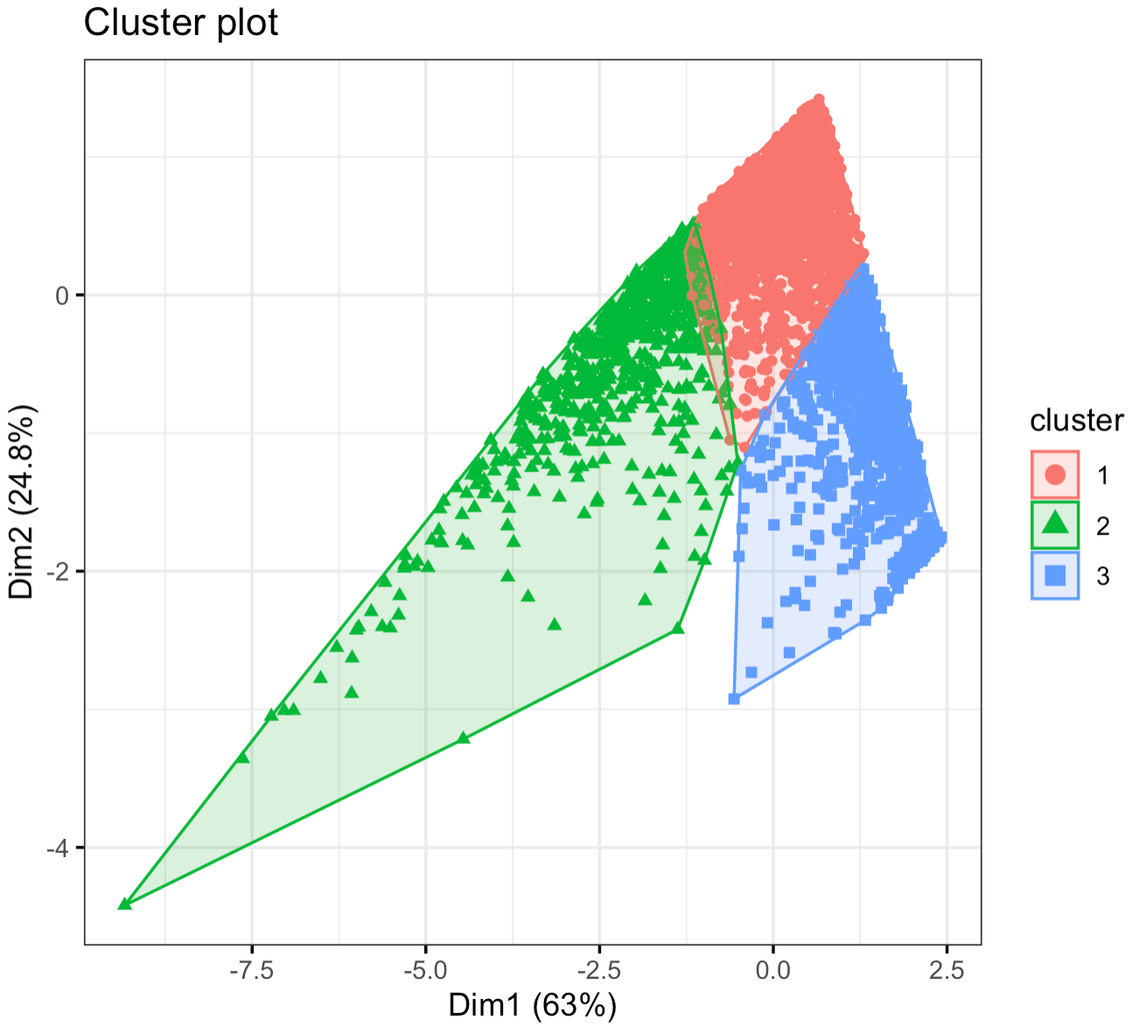
K-Means Clustering – K with Elbow Method
Elbow Method
Elbow Method gives the total Within Sum of Squared Errors for different values of K.
K = 3

Slide 12
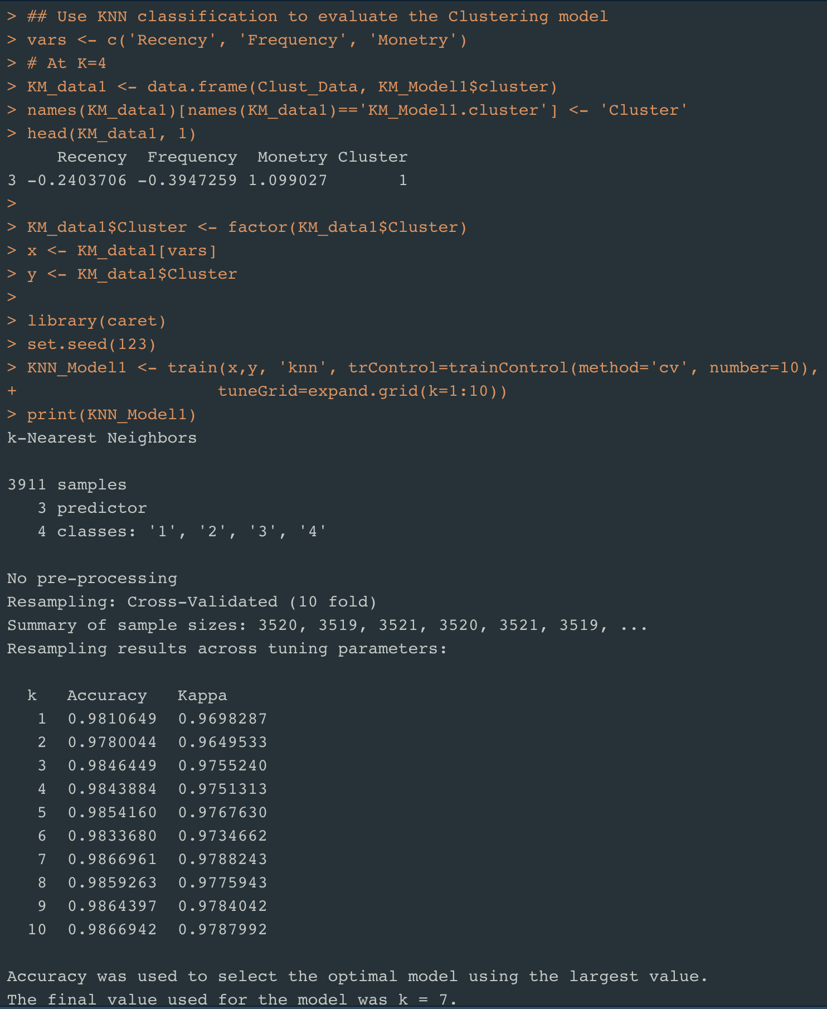
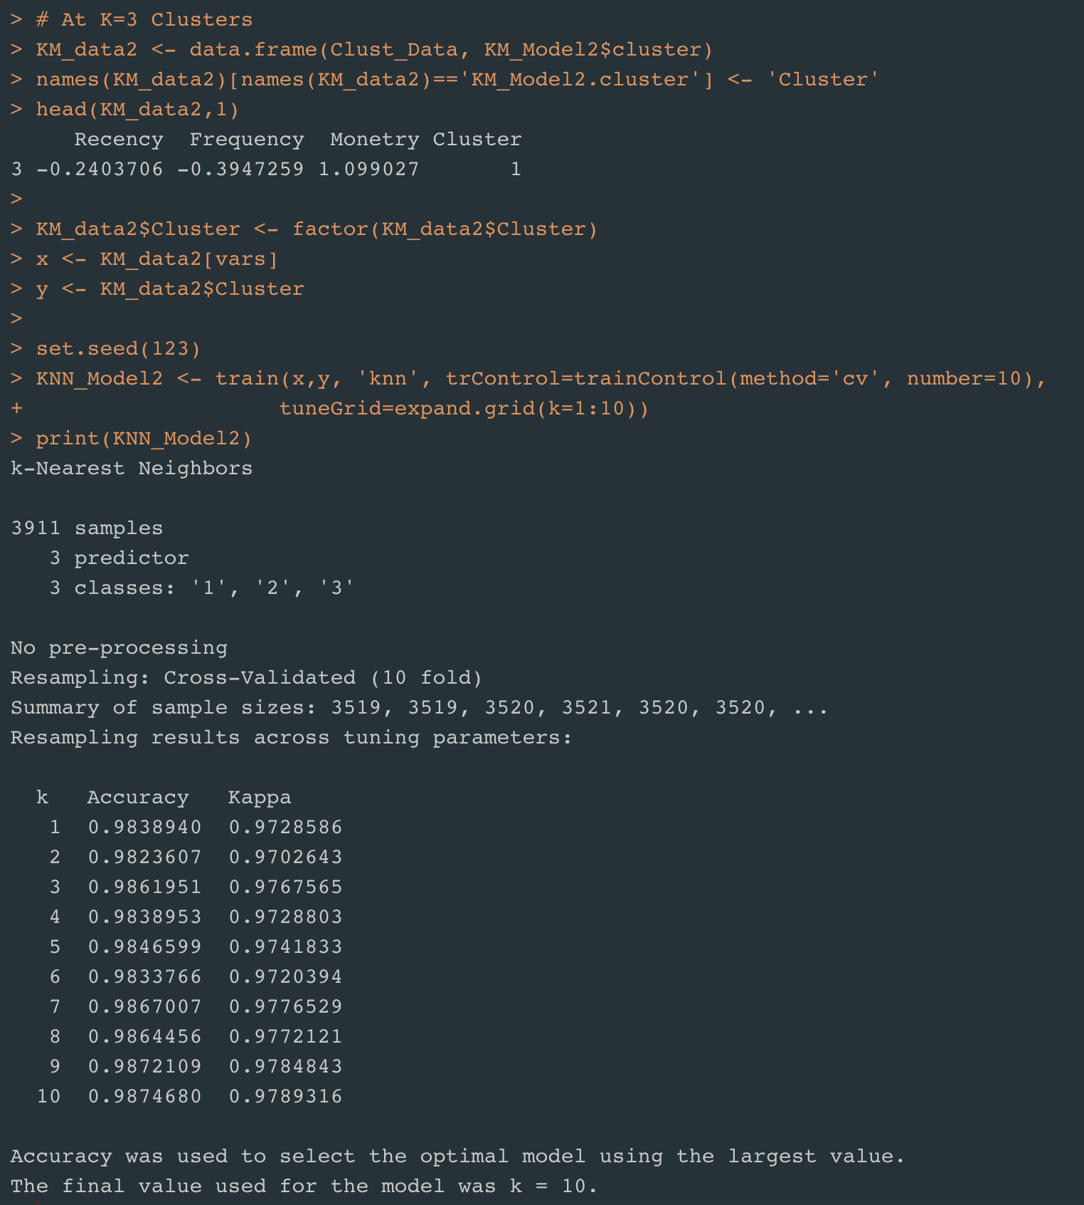
K-Means Clustering - Evaluation
Sample: 3911
N-Fold Cross Validation at N= 10
KNN Classification
Model with K= 4
Model with K= 3
Accuracy: 0.986
Accuracy: 0.987

Slide 13
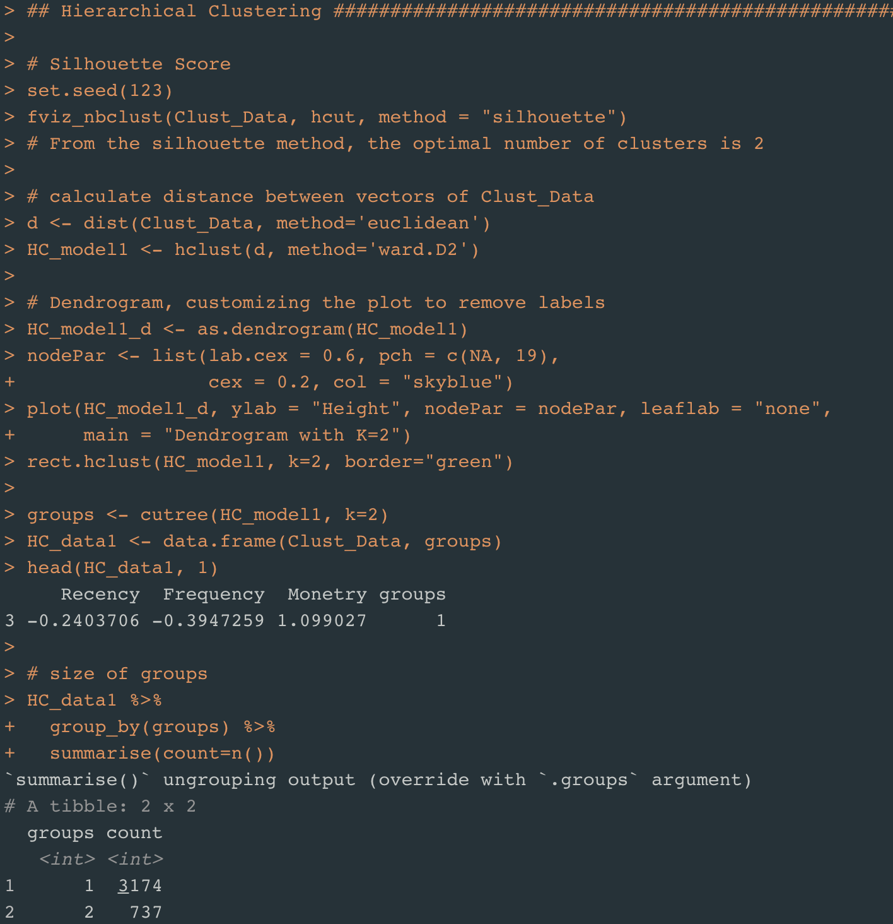
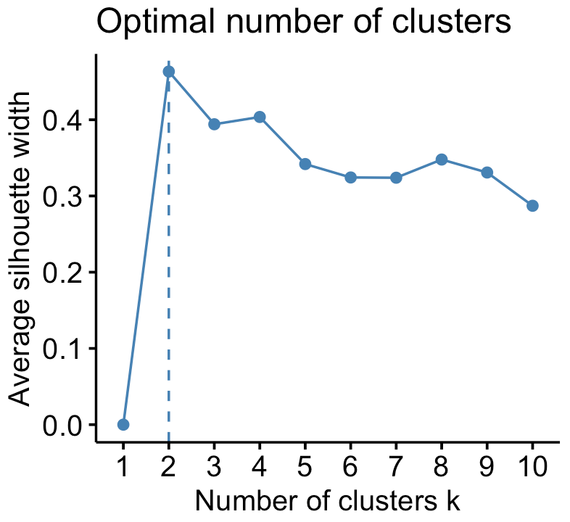
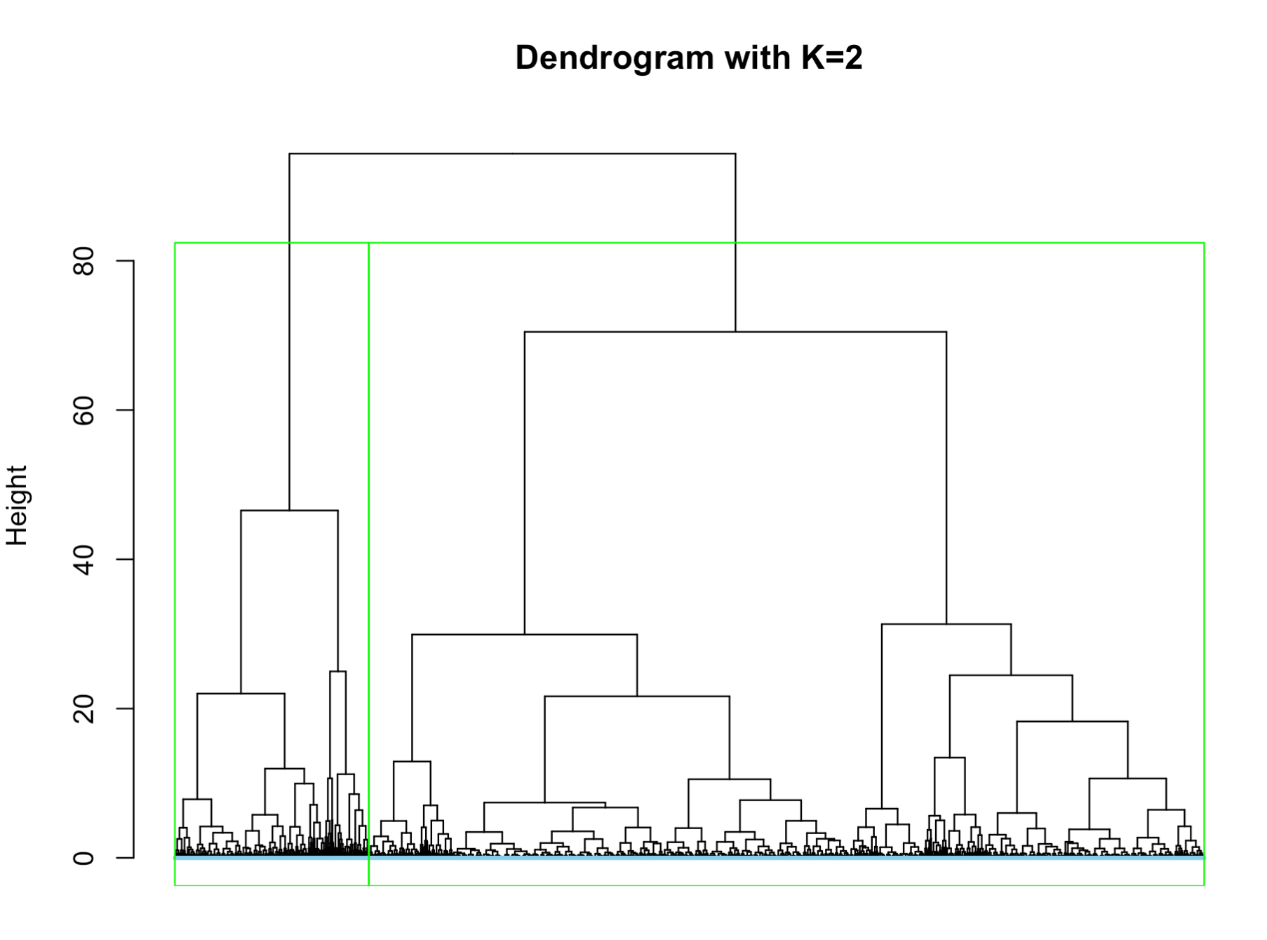
Hierarchical Clustering – K with Silhouette Method
Considering
K = 2

Slide 14
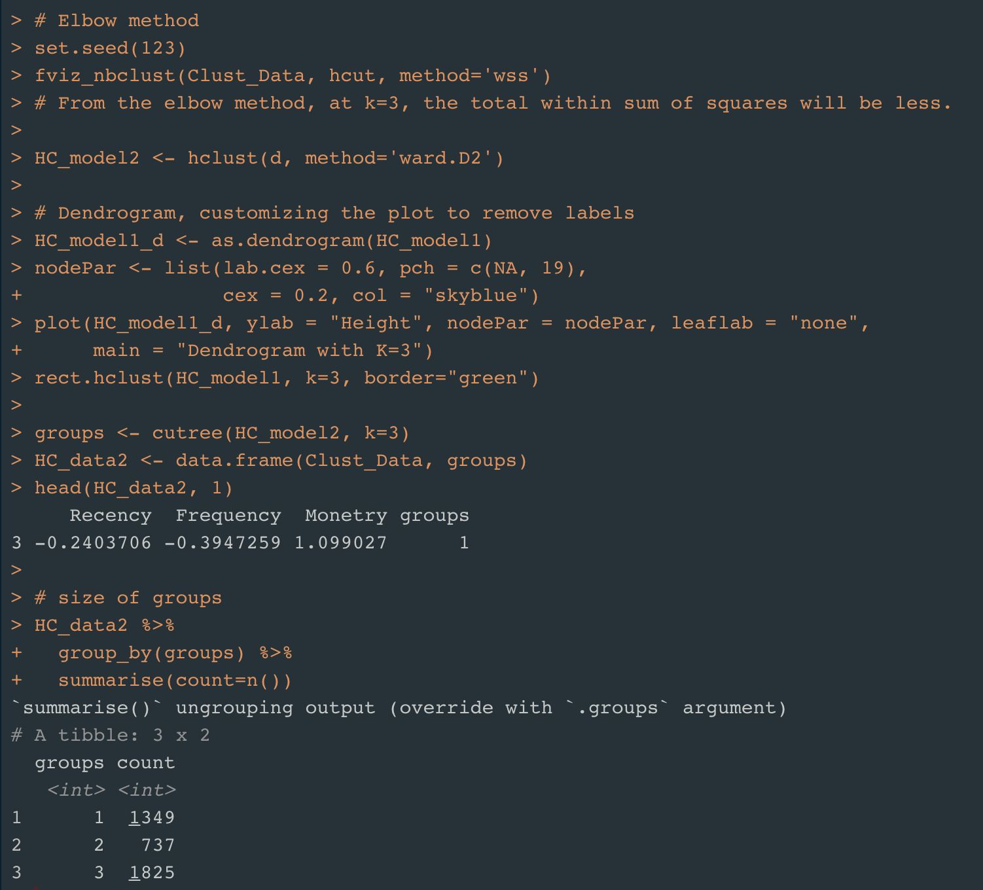
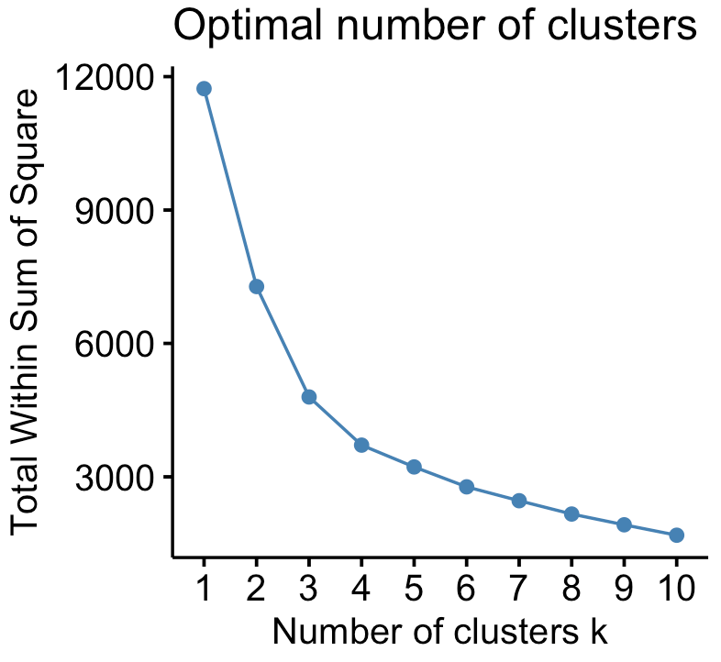
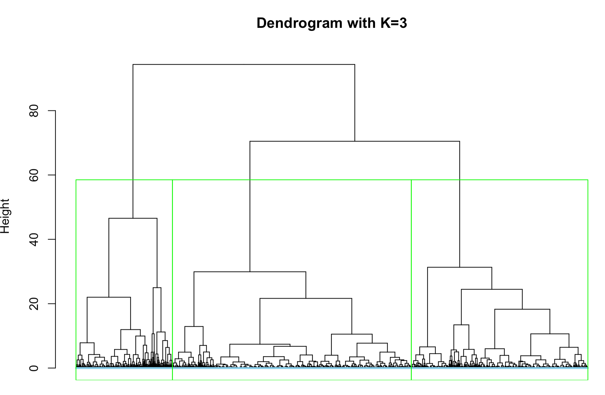
Hierarchical Clustering - K with Elbow method
Considering
K = 3

Slide 15
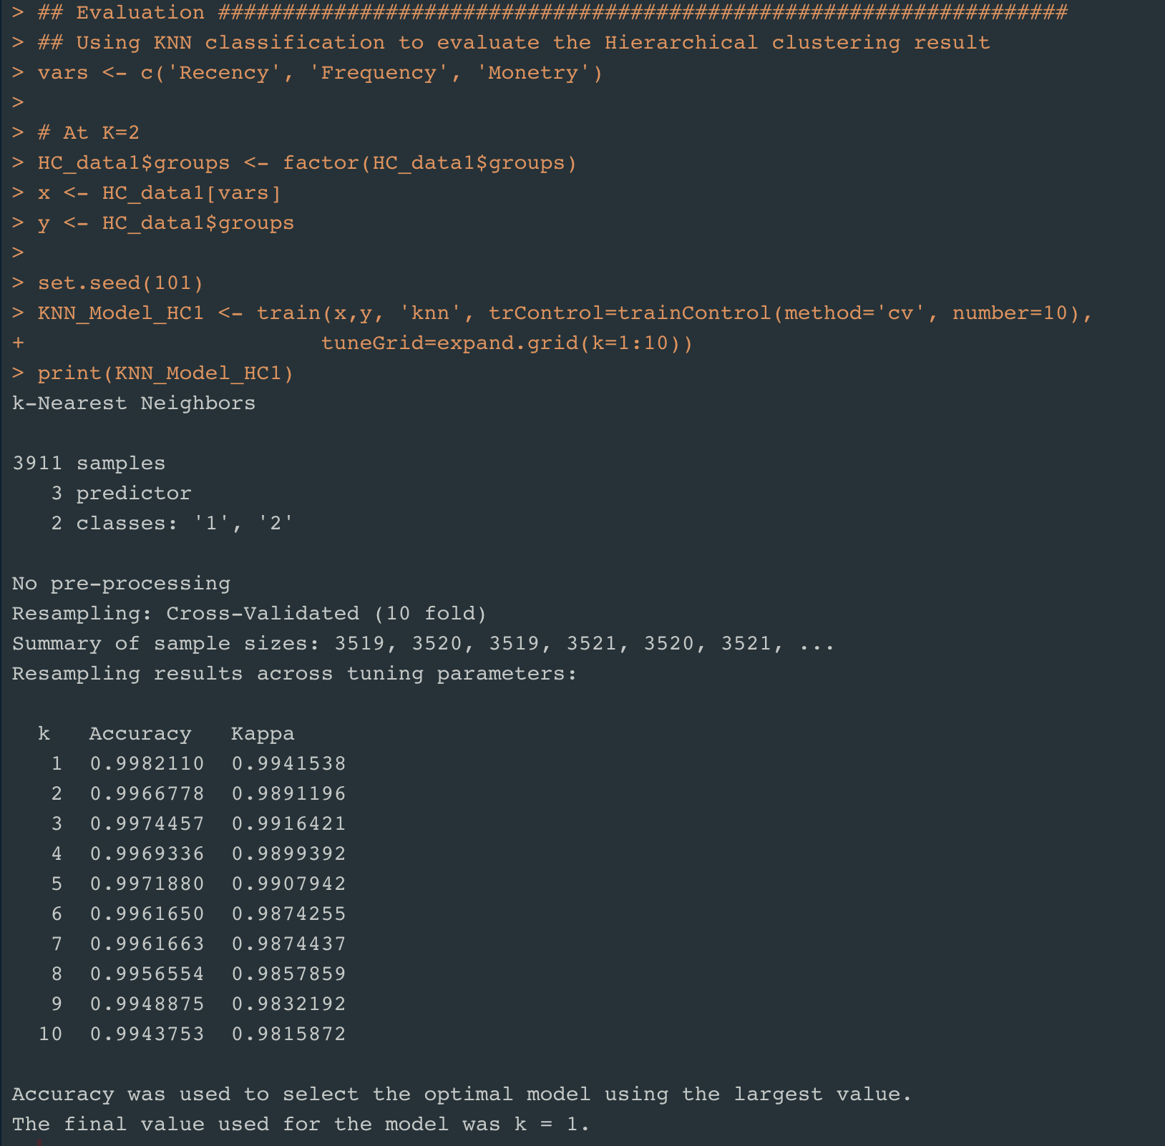
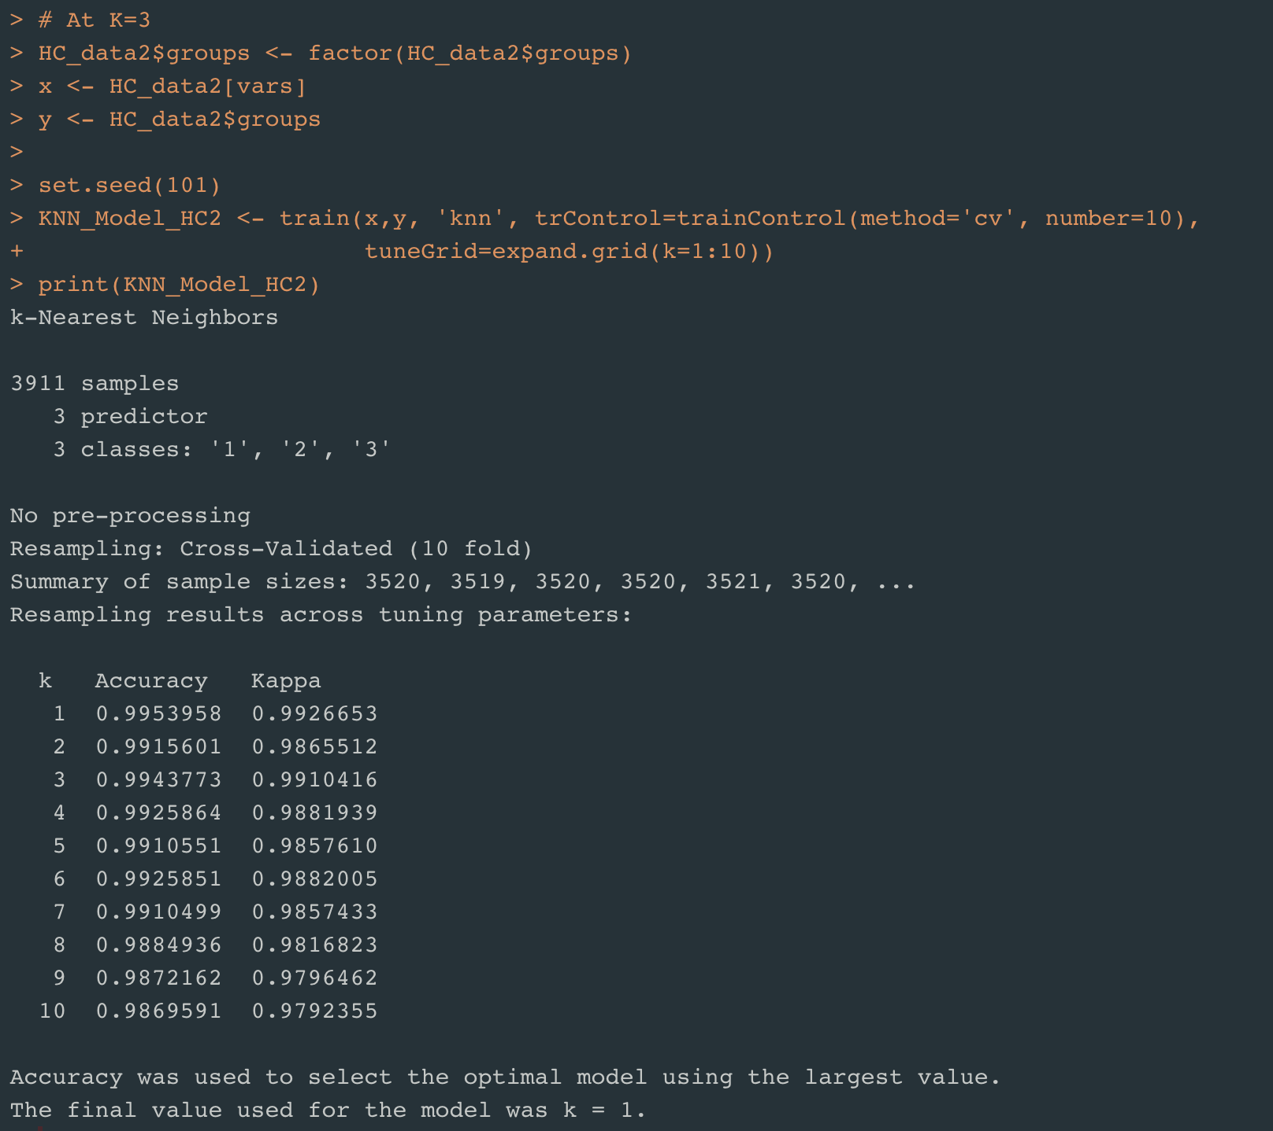
Hierarchical Clustering - Evaluation
KNN Classification
Sample: 3911
N-Fold Cross Validation at N= 10
Model with K= 2
Model with K= 3
Accuracy: 0.998
Accuracy: 0.995

Slide 16
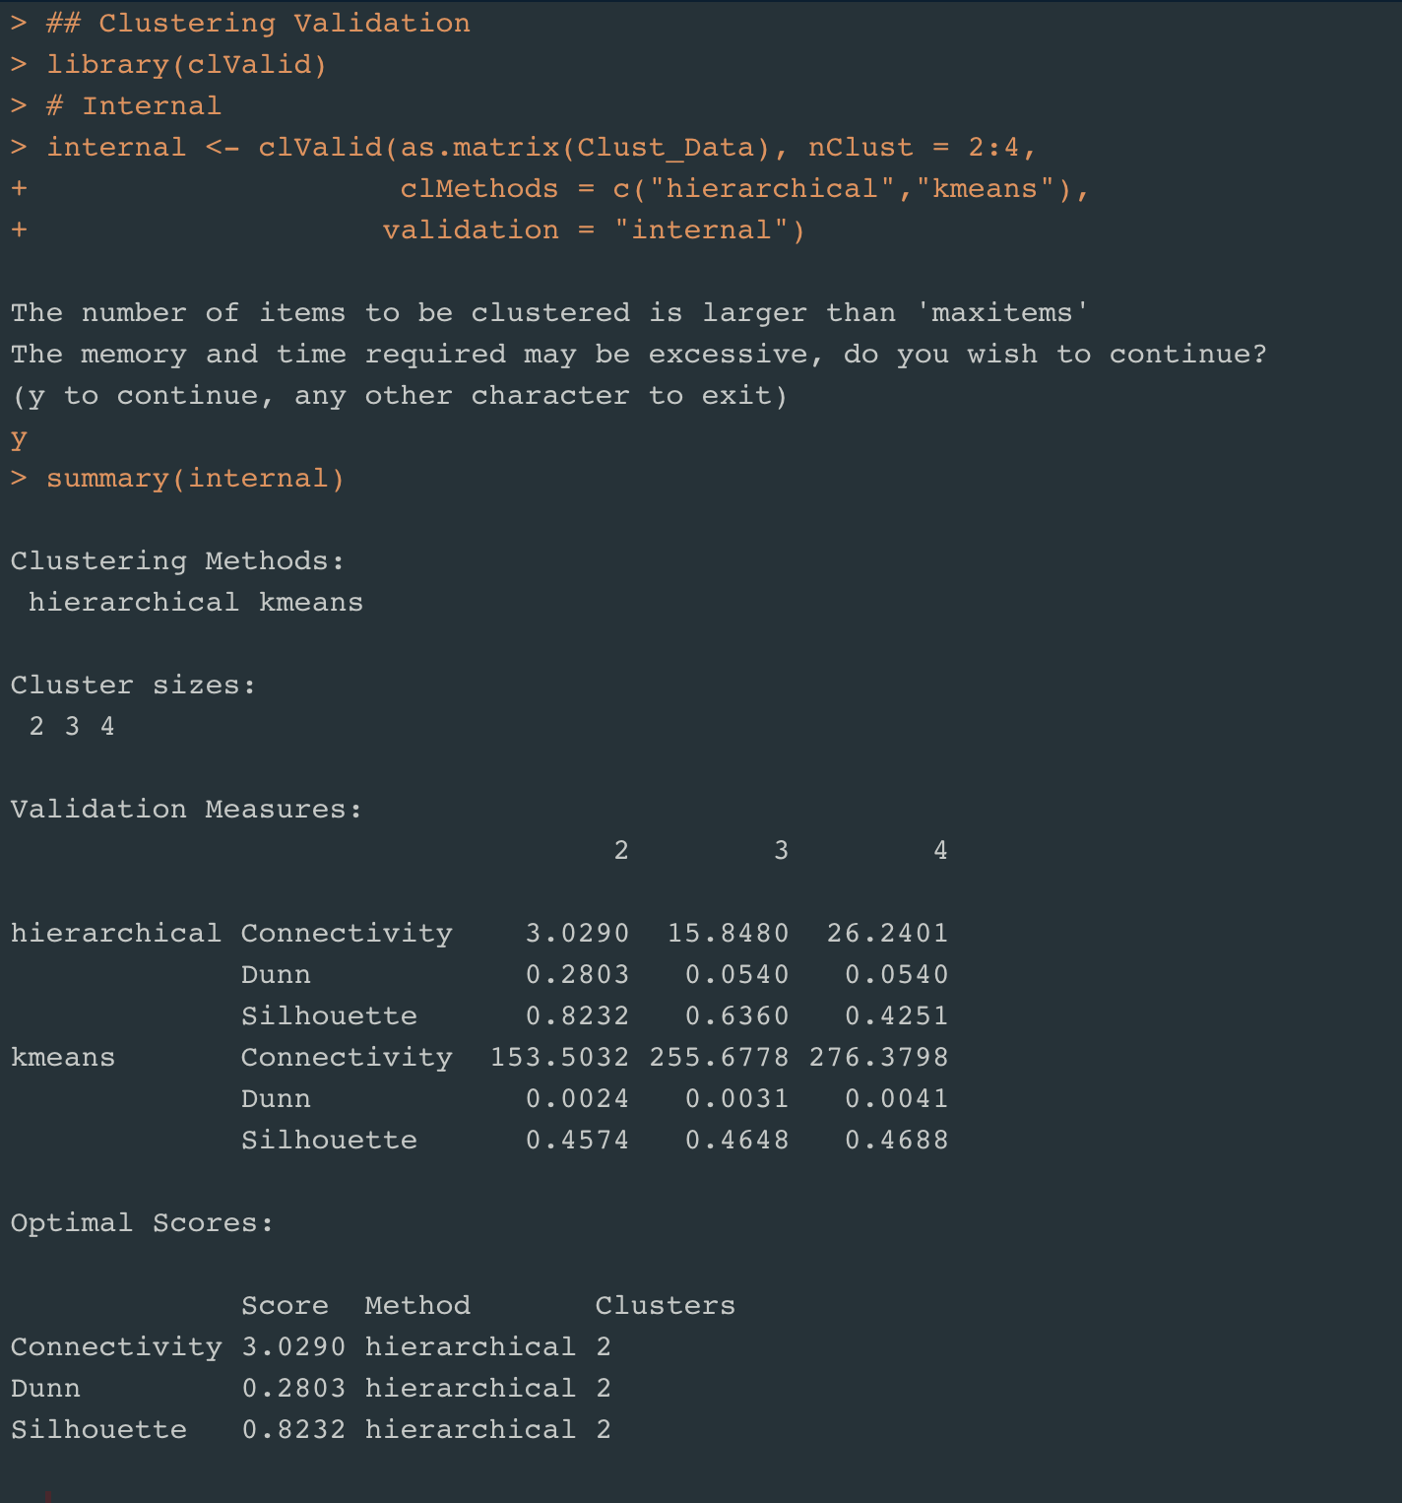
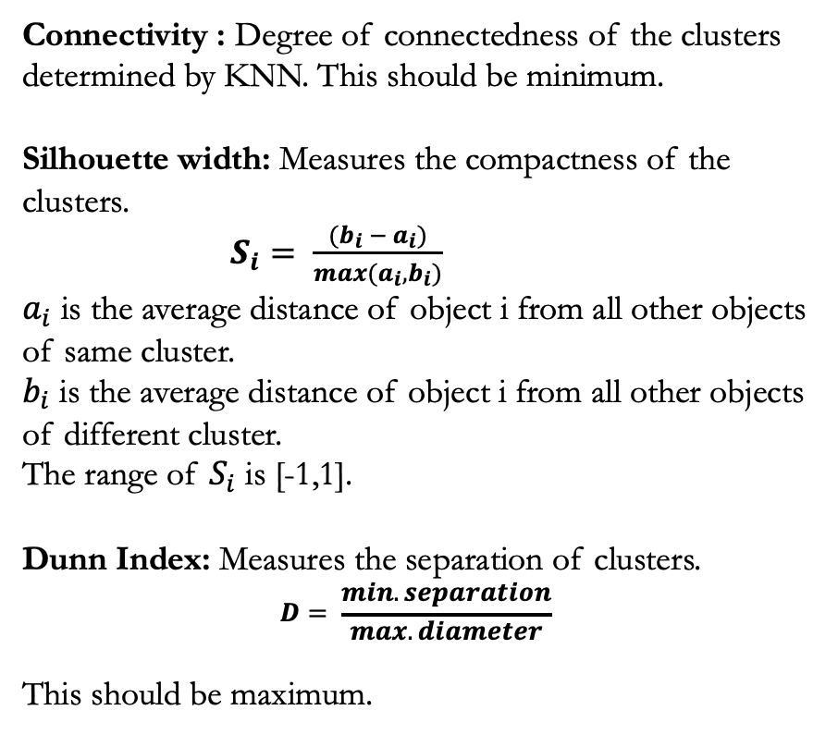
Clustering - Evaluation
Using Internal validation measures
Connectivity : Degree of connectedness of the clusters determined by KNN. This should be minimum.
Silhouette width: Measures the compactness of the clusters.
$S_{i}= \frac{(b_{i} − a_{i})}{max(a_{i},b_{i})}$
$a_{i}$ is the average distance of object i from all other objects of same cluster.
$b_{i}$ is the average distance of object i from all other objects of different cluster.
The range of $S_{i}$ is [-1,1].
Dunn Index: Measures the separation of clusters.
$$D= \frac{min.separation}{max.diameter}$$
This should be maximum.

Slide 17
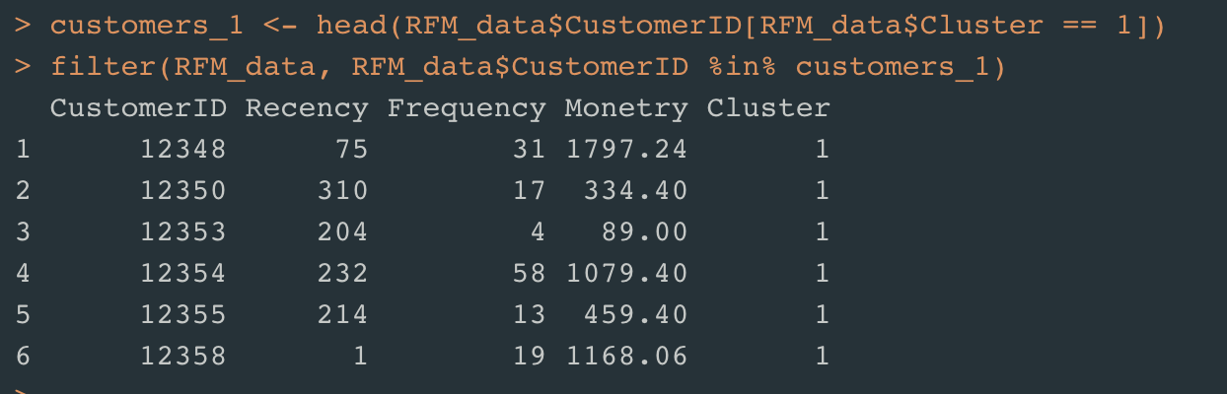
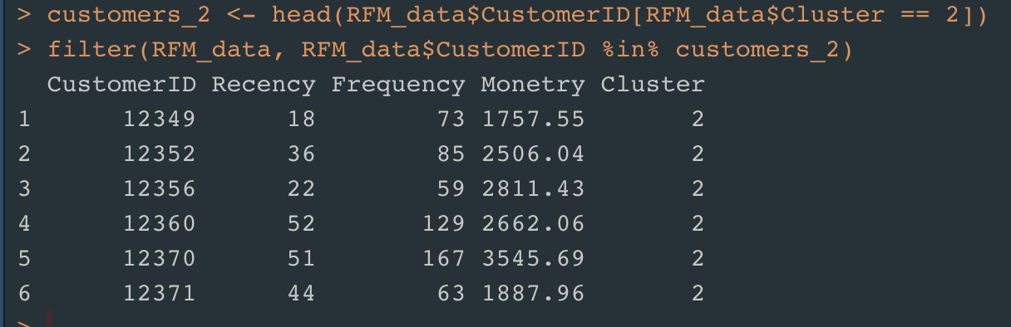
Customer Segmentation - Conclusion
Using KNN Classification
Accuracy
K-Means Clustering |  | Hierarchical Clustering
K = 4 | K =3 | K = 2 | K = 3
0.986 | 0.987 | 0.998 | 0.995
Cluster 1 is of the customers who are either with More Recency or Less Frequency or Less Monetary in the online Retail.
Cluster 2 is of the customers who are Recent, Frequent and spent more amount in the online Retail.
Customers in Cluster 2 are Loyal Customers.

Slide 18
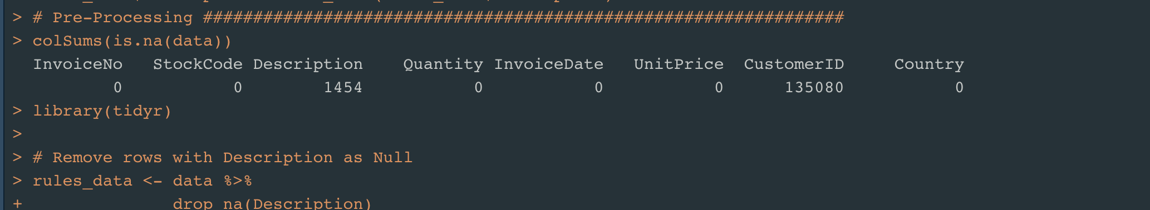
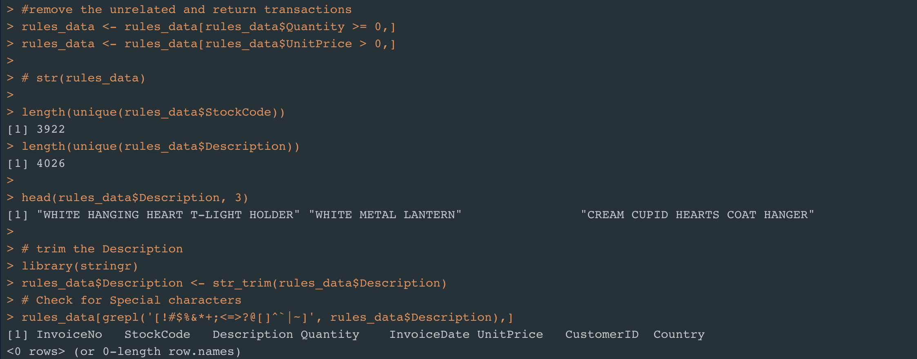
Market Basket Analysis – Association rules
Pre-Processing the data
Handle Missing values
Removed return transactions
Trim the description
Check for special characters in the description
Check for the number of unique stock codes and unique descriptions

Slide 19
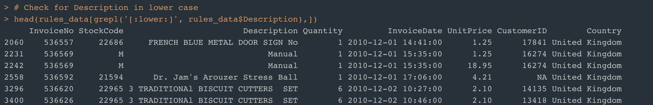
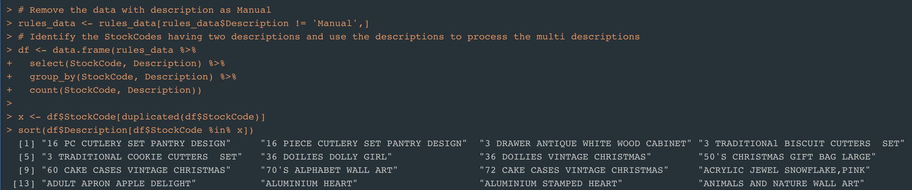
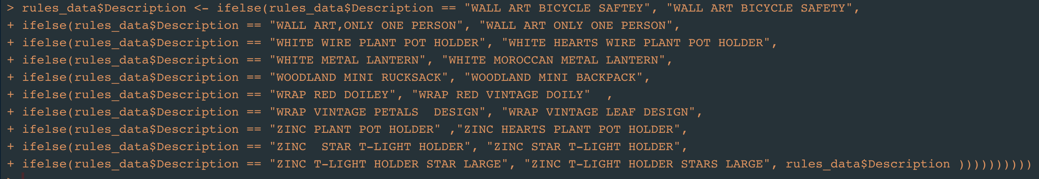
Market Basket Analysis – Pre-Processing the data
Handle data with no valid Description
Handle data with typo errors in Description

Slide 20
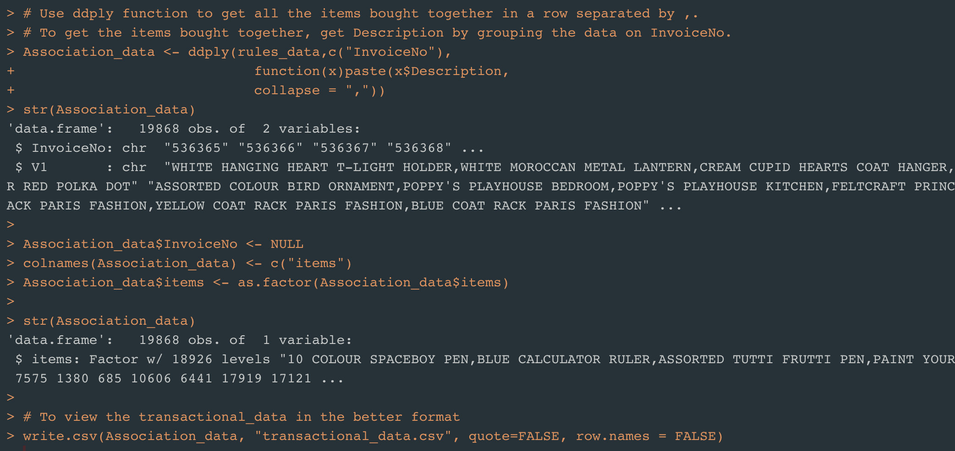
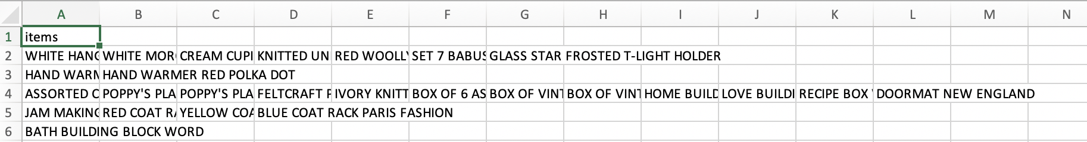
Market Basket Analysis – Format the data

Slide 21

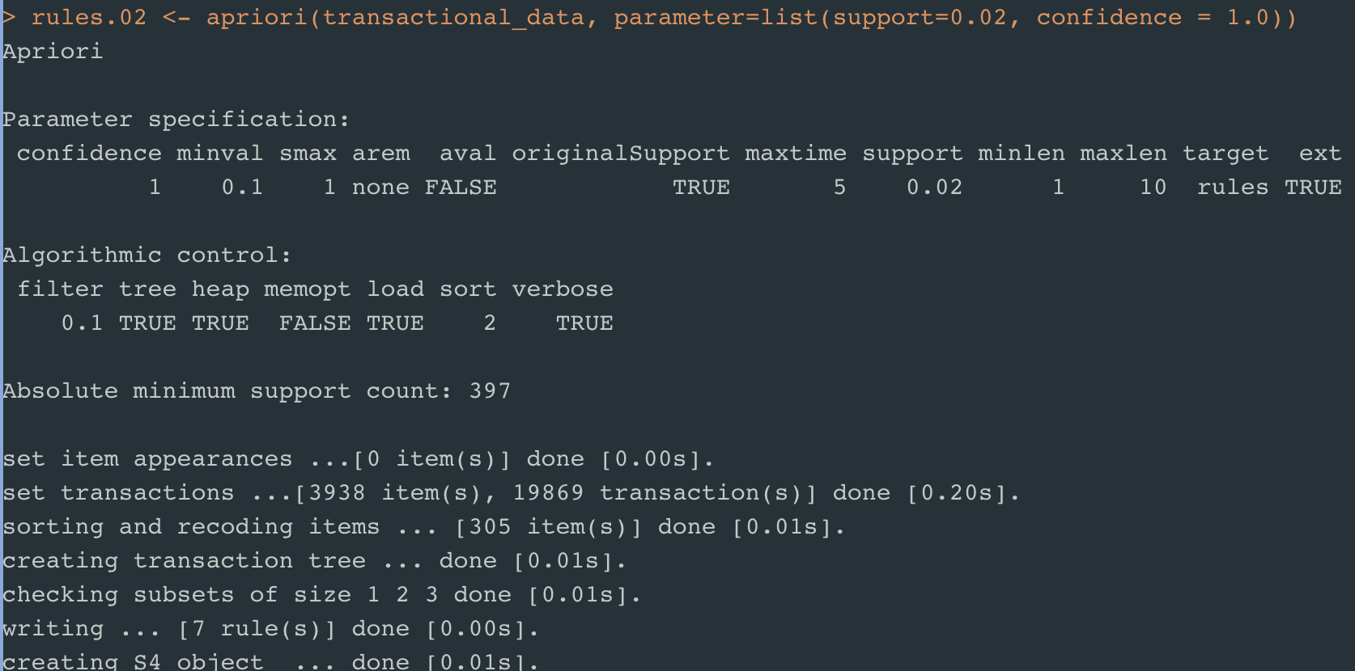
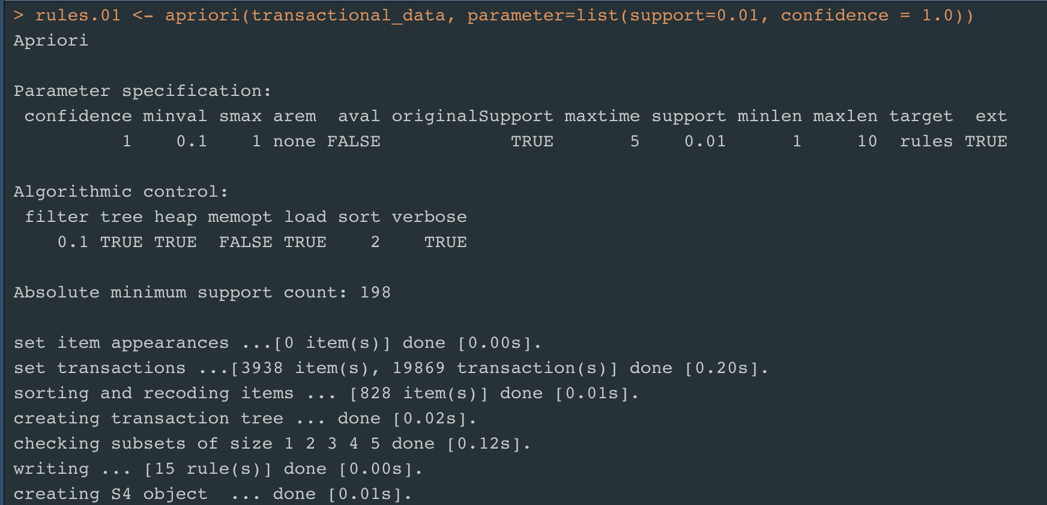
Association Rules – Apriori Algorithm
For Confidence = 1.0 and Support =0.02
- 7 Association Rules
For Confidence = 1.0 and Support =0.01
- 15 Association Rules

Slide 22
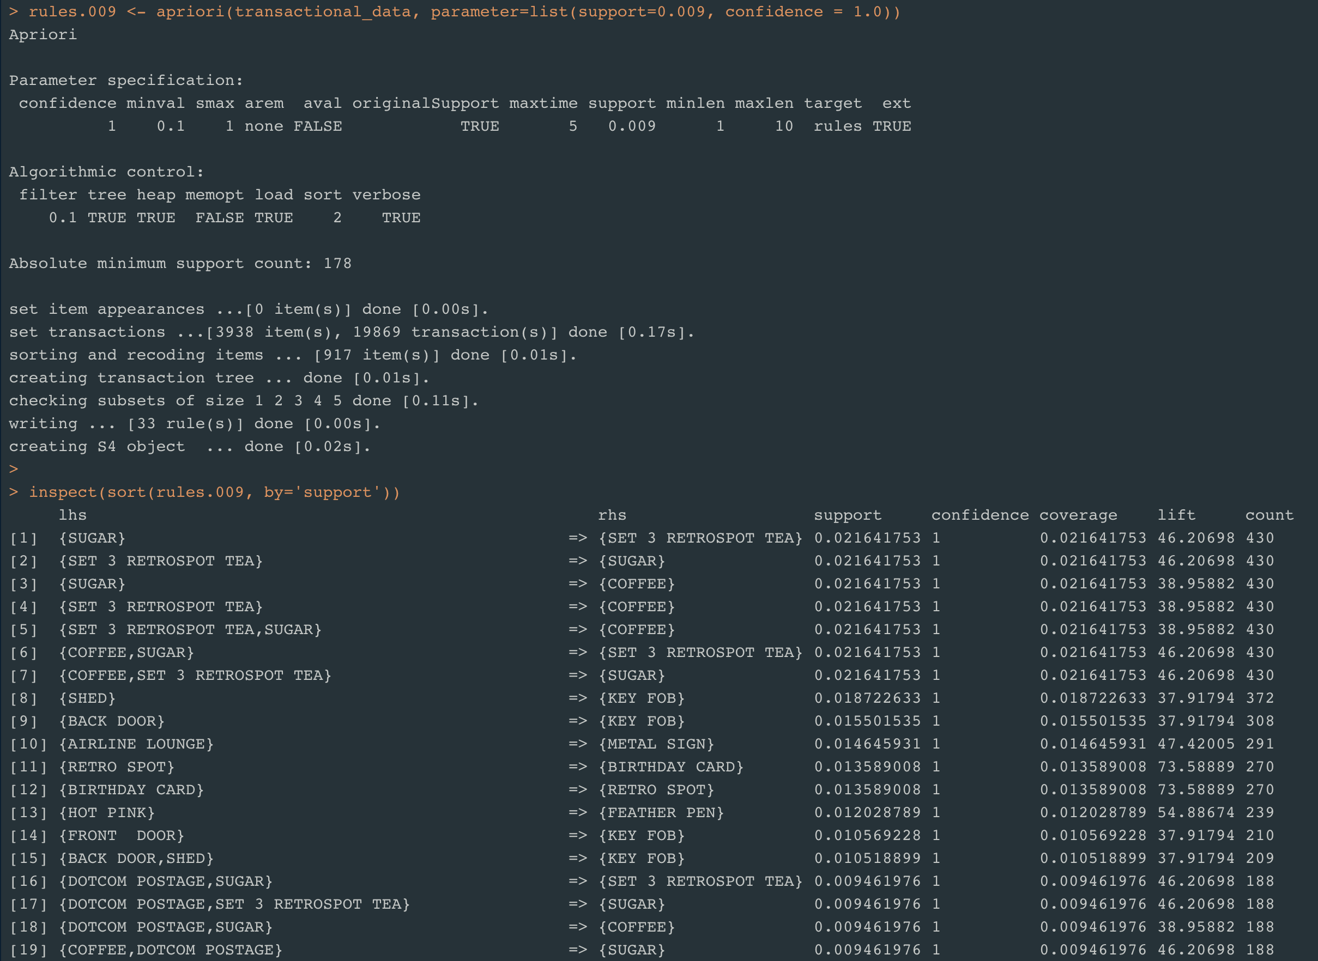
Inspect Association Rules

Slide 23
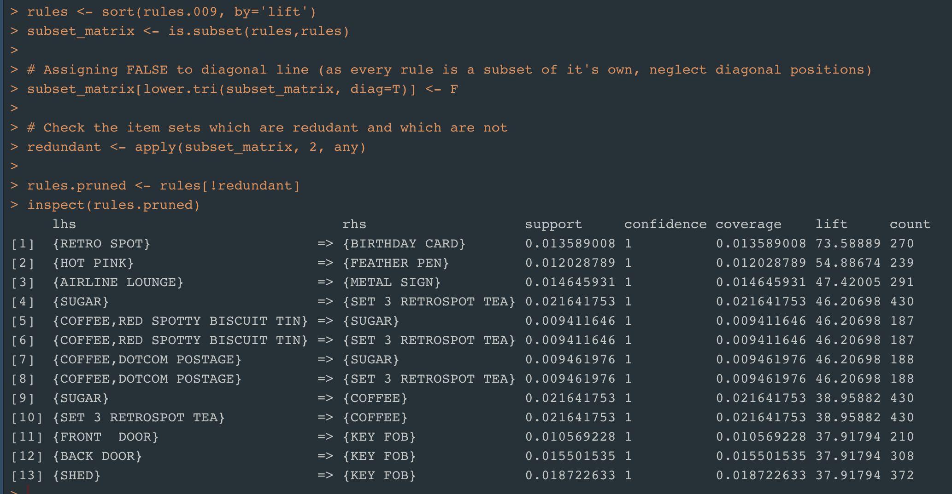
Prune Redundant Association Rules

Slide 24
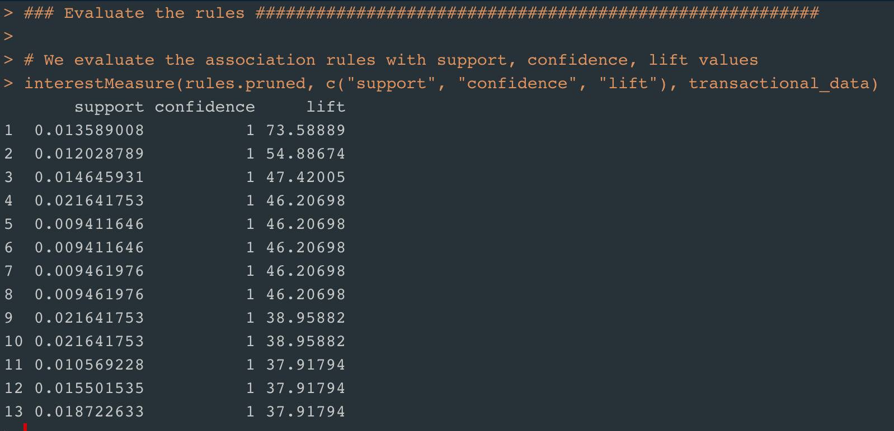
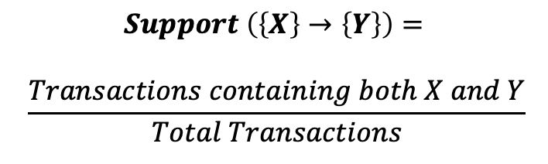

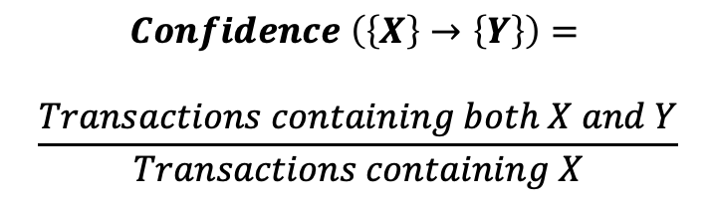
Association rules Evaluation
$$Support \left(\left\{X\right\}→\left\{Y\right\}\right)=$$
$$\frac{Transactions containing both X and Y}{Total Transactions}$$
$$Confidence \left(\left\{X\right\}→\left\{Y\right\}\right)=$$
$$\frac{Transactions containing both X and Y}{Transactions containing X}$$
$$Lift \left(\left\{X\right\}→\left\{Y\right\}\right)= \frac{(Transactions containing both X and Y)/(Transactions containing X)}{Fraction of transcations containingY}$$

Slide 25
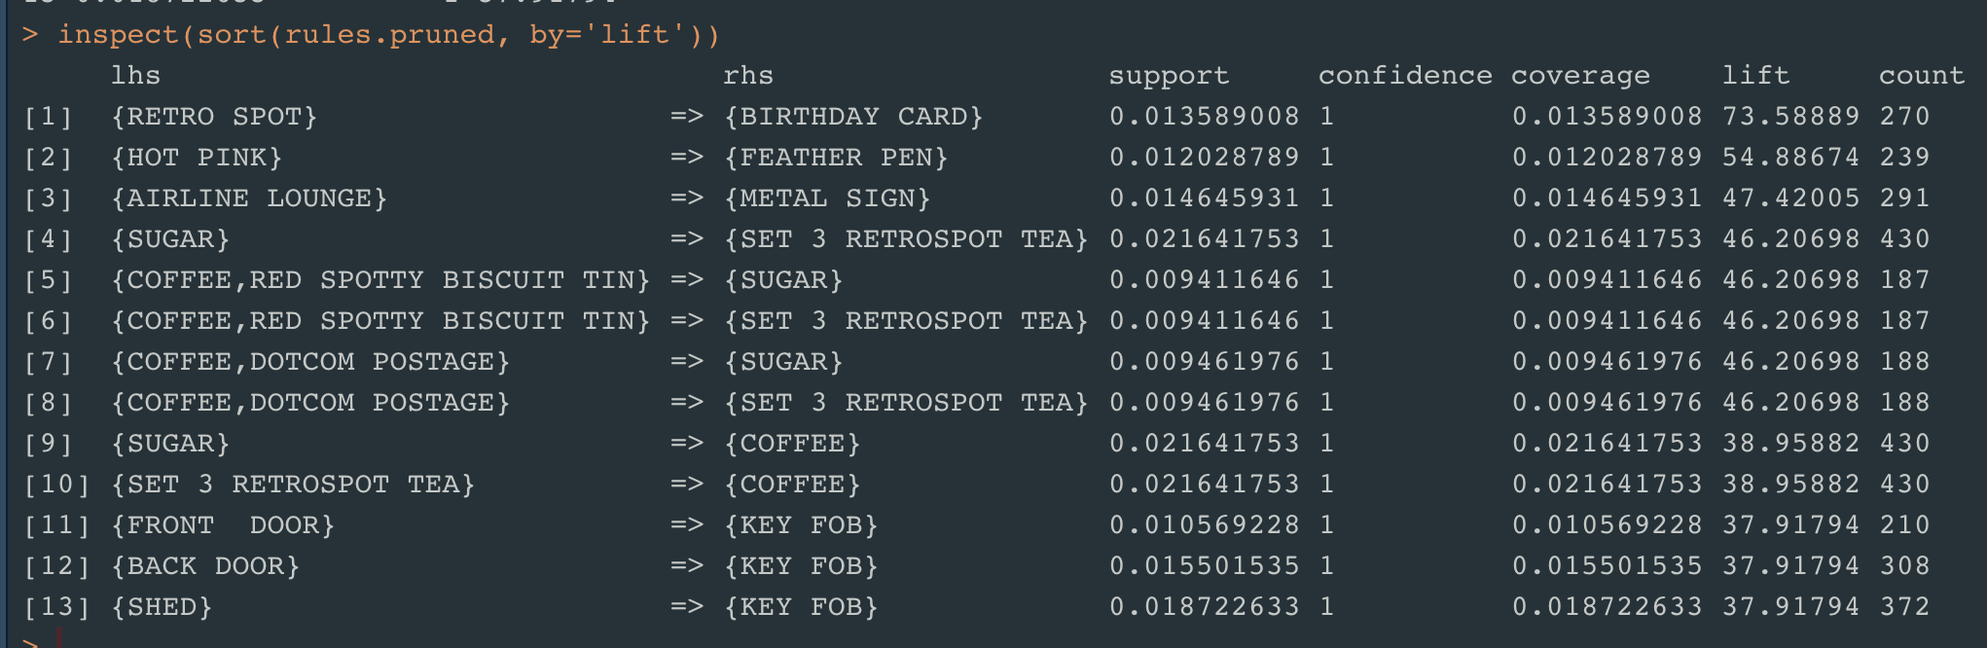
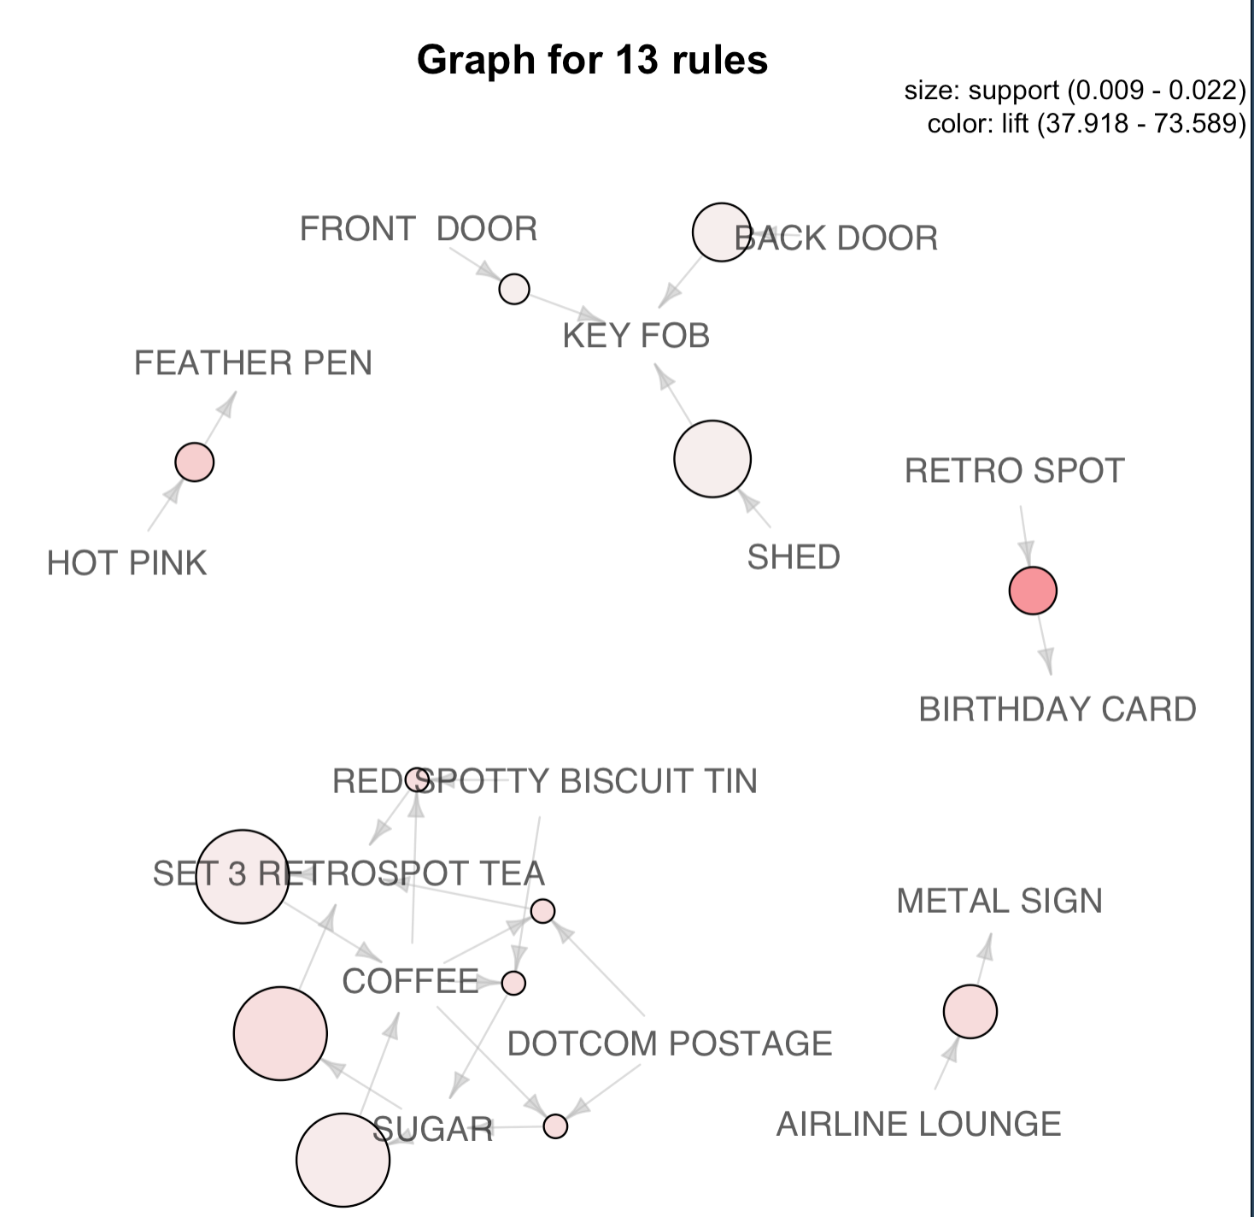

Top 13 Association rules

Slide 26

CONCLUSION
Identify the customers into different groups based on their behavior with the online retail.
Identify the Loyal Customers.
Customers of online-retail have been segmented into two groups with 99.8% accuracy using their Recency, Frequency and Monetary values.
Group 1 – either with More Recency or Less Frequency or Less Monetary.
Group 2 – Less Recency, More Frequency and More Monetary.
Group 2 customers are identified as Loyal Customers.
Identify Top 10 Association rules for the products purchased in the online retail.
Top 10 Association rules with
100%confidence,
order by lift value.

Slide 27

FUTURE WORK
Use Gap-Statistic Method to find the optimal number of clusters for clustering.
Use Density based and K-mediods clustering algorithms for Customer segmentation.
Inspect Association rules with confidence levels 0.8, 0.7 and so.. .Business can use these rules in designing lossless promotional offers for the products.

Slide 28
THANK YOU

